Slide 1
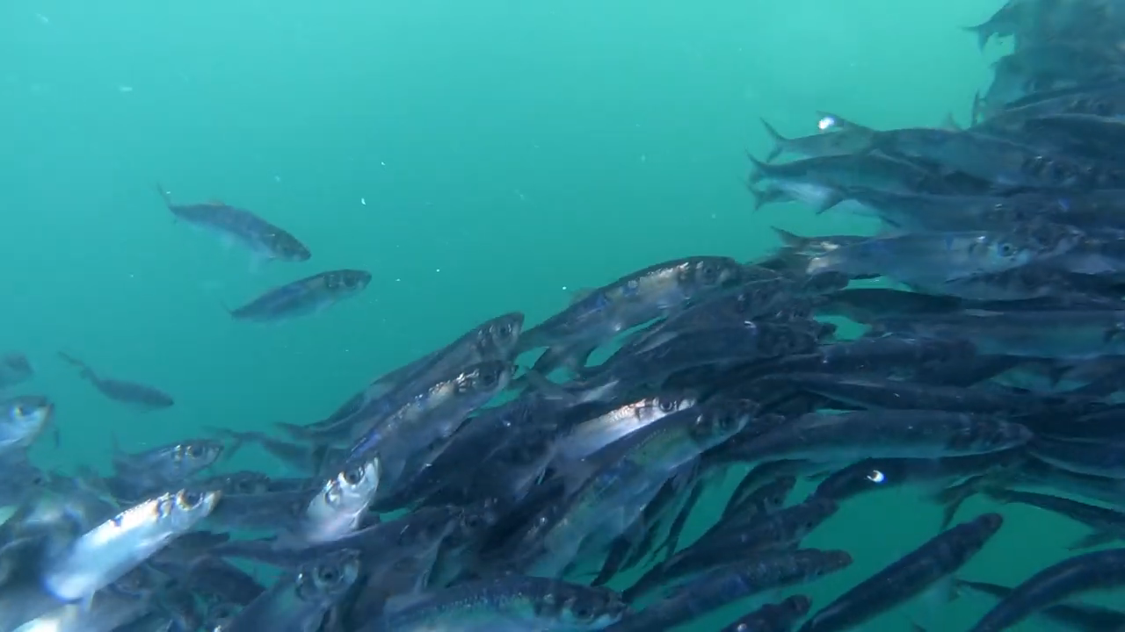

Using temporal genomic contrasts to understand Pacific herring population recovery following the Exxon Valdez oil spill
Joe McGirr
Postdoctoral Researcher
Whitehead Lab
Department of Environmental Toxicology
University of California Davis
Video credit: Karac Lindsay

Slide 2

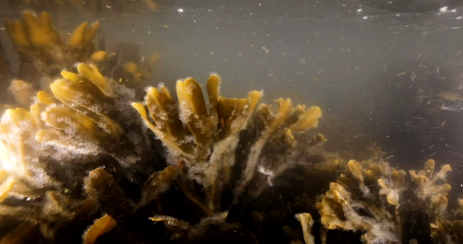
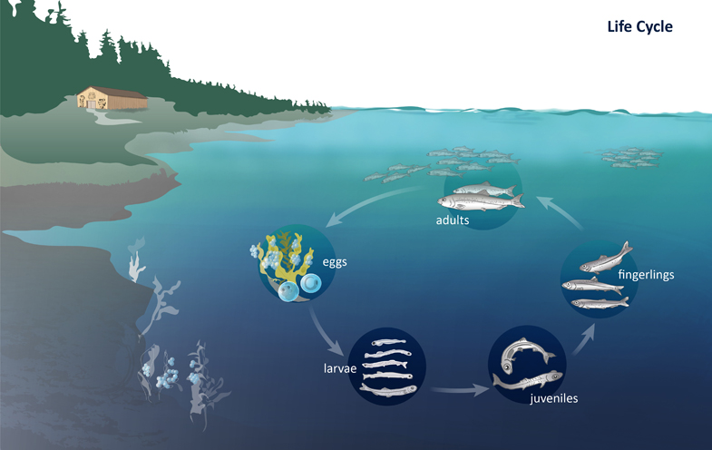
Video credit: Ian McAllister
Notes:
Pacific herring is a coastal schooling species found on the eastern and western sides of the Pacific. Schools of mature adults migrate into estuaries to breed once a year where spawning occurs on kelp and eelgrass. A single female can produce up to 20,000 eggs. After those eggs hatch, it takes about three to four years for the herring to mature and join up with other adults in large schools. At each stage of their life cycle, herring are an important food source, and because many species in a complex food web depend on Pacific herring and their eggs, it is considered keystone species.

Slide 3

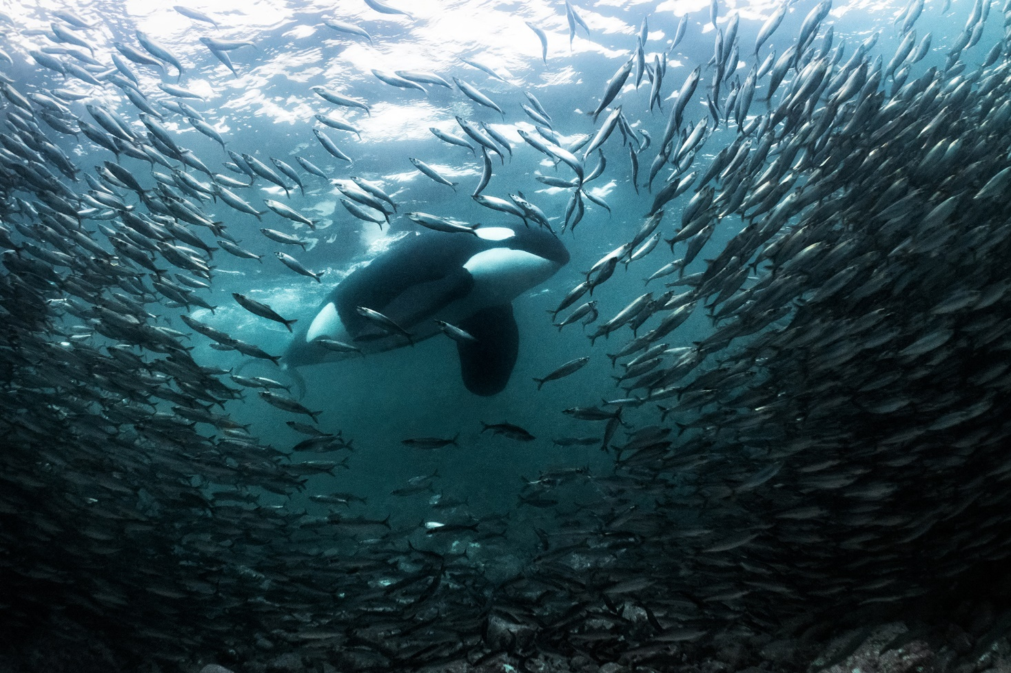
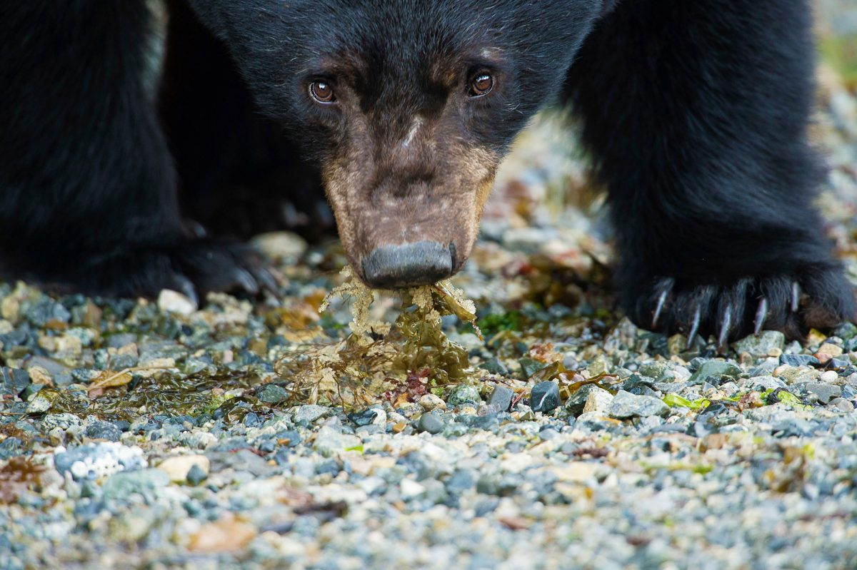
Notes:
After those eggs hatch, it takes about three to four years for the herring to mature and join up with other adults in large schools. At each stage of their life cycle, herring are an important food source, and because many species in a complex food web depend on Pacific herring and their eggs, it is considered keystone species.

Slide 4
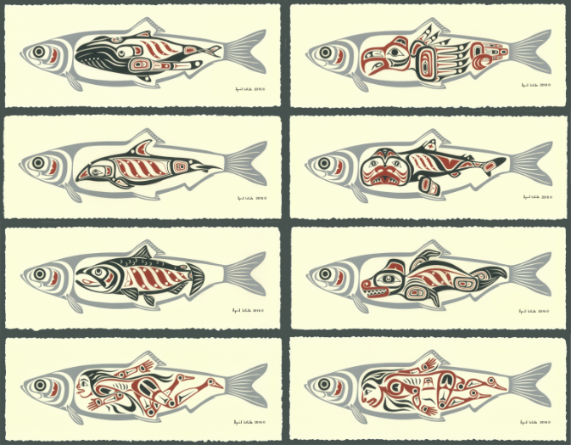
April White
Notes:
One part of that complex food web includes humans. This is artwork by April White, a member of the Haida indigenous group from the coast of British Colombia where herring have been culturally important for centuries. The prints show many of the species that depend on herring inside a herring’s stomach, including a human down here.

Slide 5
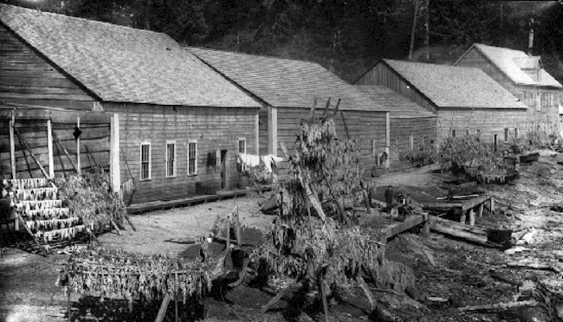
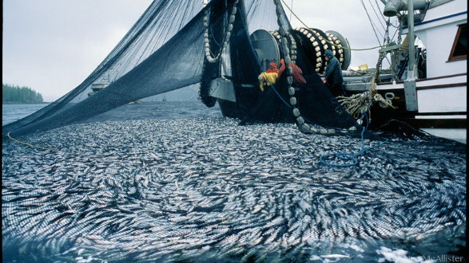
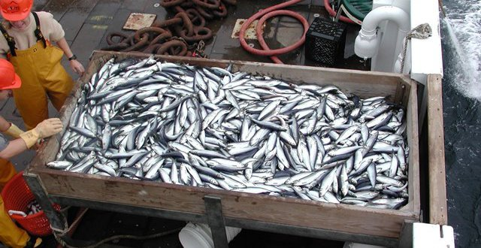
Pacific herring and humans
Harvested by coastal indigenous communities
Main export:
dry-salted
Main export:
roe/spawn on kelp and bait
Main export:
meal and oil
1882
First commercial fisheries in Alaska
1930s
1960s
Present
Notes:
The first commercial fisheries in Alaska began in the late 1800s and expanded rapidly, with catches in the thousands of tons by the early 1900s. Today, Pacific herring remain ecologically, culturally, and commercially important species. So we want to be able to understand how populations change over time in order to maintain healthy ecosystems and manage sustainable fisheries.

Slide 6
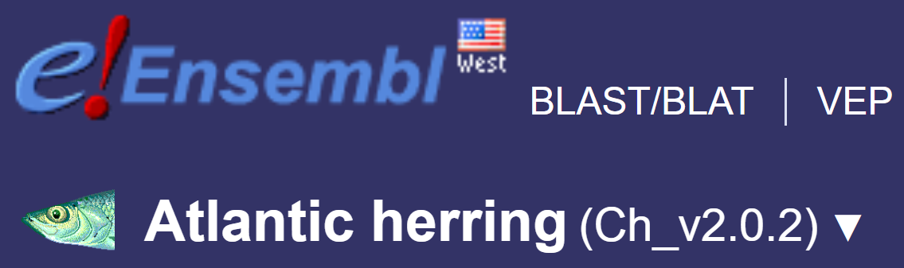
Atlantic herring: A model for population genetics
Giant population size
Random mating
Chromosome-level genome assembly
Mutation rate (2×10⁻⁹)
Moderate nucleotide diversity (π = 0.3%)
Tiny Ne/Nc ratio (10⁵ / 10¹²)
Feng et al. 2017, elife. Pettersson et al. 2019 Genome Research
Notes:
Another way that herring have been important to humans is in studies of population genetics. There has been a lot of this type of research on Atlantic herring, which are about 3 million years diverged from Pacific herring. This is because they come close to meeting some assumptions that population geneticists like to make regarding infinite population size and random mating. They are one of the most abundant vertebrates on earth and they reproduce in these really large spawning groups. As a result of all of this research, there are very nice resources for Atlantic herring, including a chromosome level assembly and a known mutation rate. Despite their huge census size, estimated to be around 1 trillion, herring show nucleotide diversity that is pretty middle of the road for vertebrates and they have a pretty small effective population size.

Slide 7
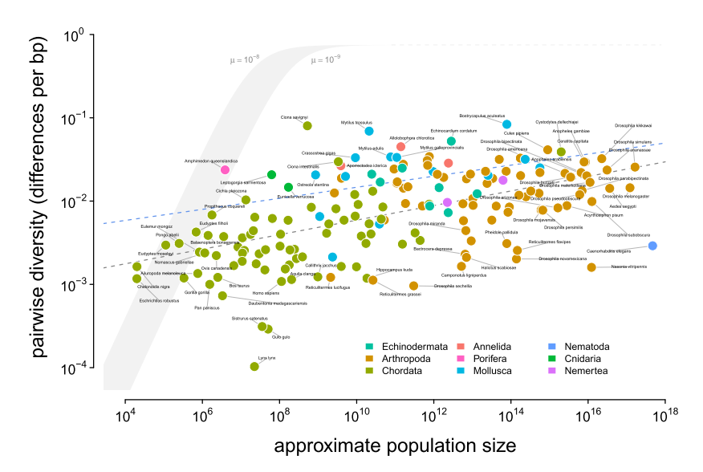

Lewontin’s Paradox
Vince Buffalo
herring
Buffalo 2021, bioRxiv
Notes:
This makes them a extreme example related to Lewontin’s Paradox, which suggests that, under neutral theory, larger populations should contain more genetic variation than what is observed. For those of you that have seen Vince Buffalo’s new preprint, this is where herring fall on the spectrum with other organisms, with really moderate genetic variation despite a huge population size. Lucky for me, this is part of what’s made Vince interested in the system and we’ve been collaborating on a lot of the work I’ll present today.

Slide 8
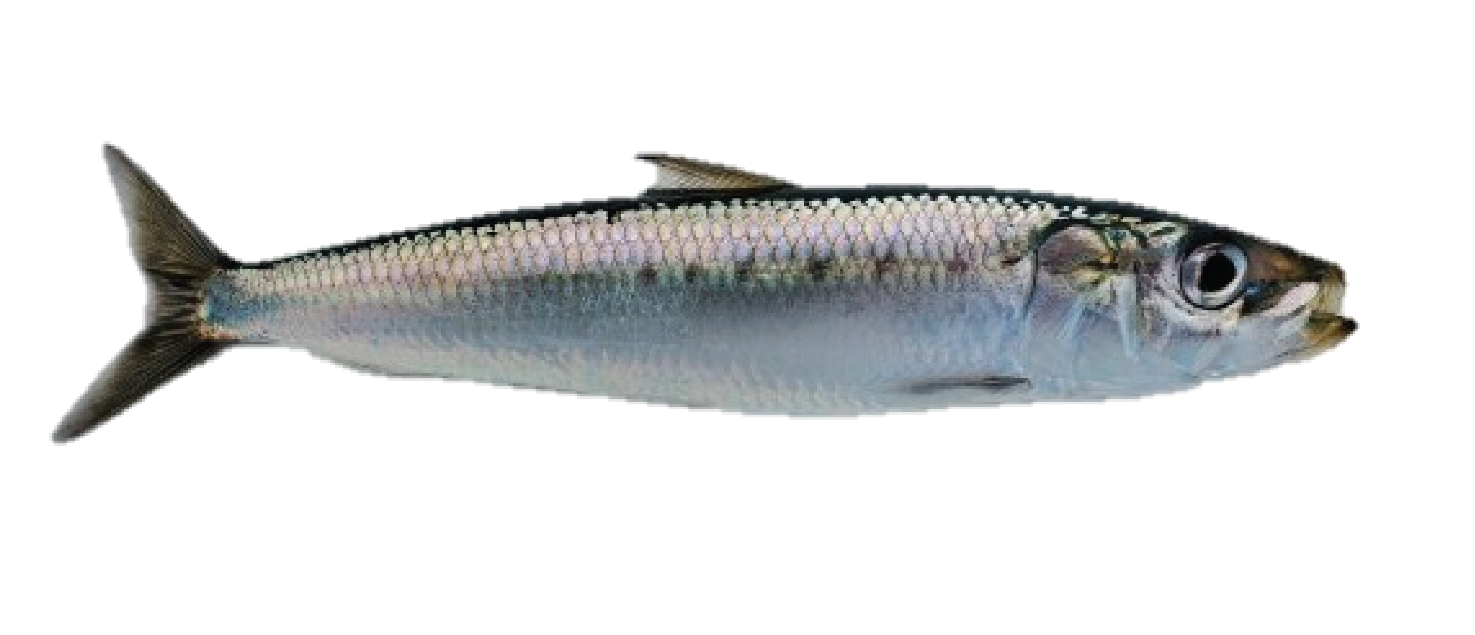
Outline
Genetic variation underlying pollution resistance and susceptibility to disease.
Inversions underlying local adaptation.

Slide 9
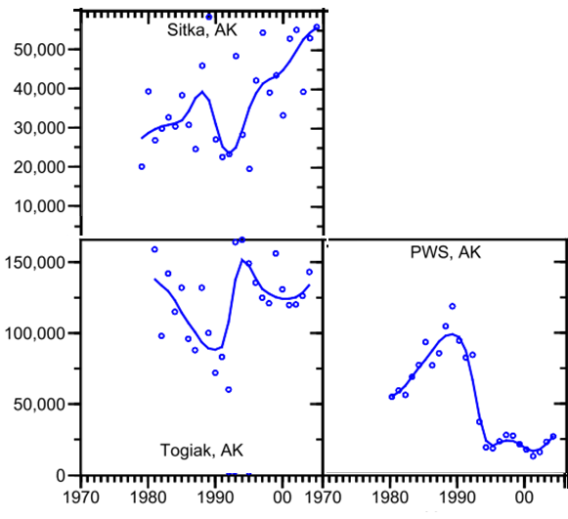
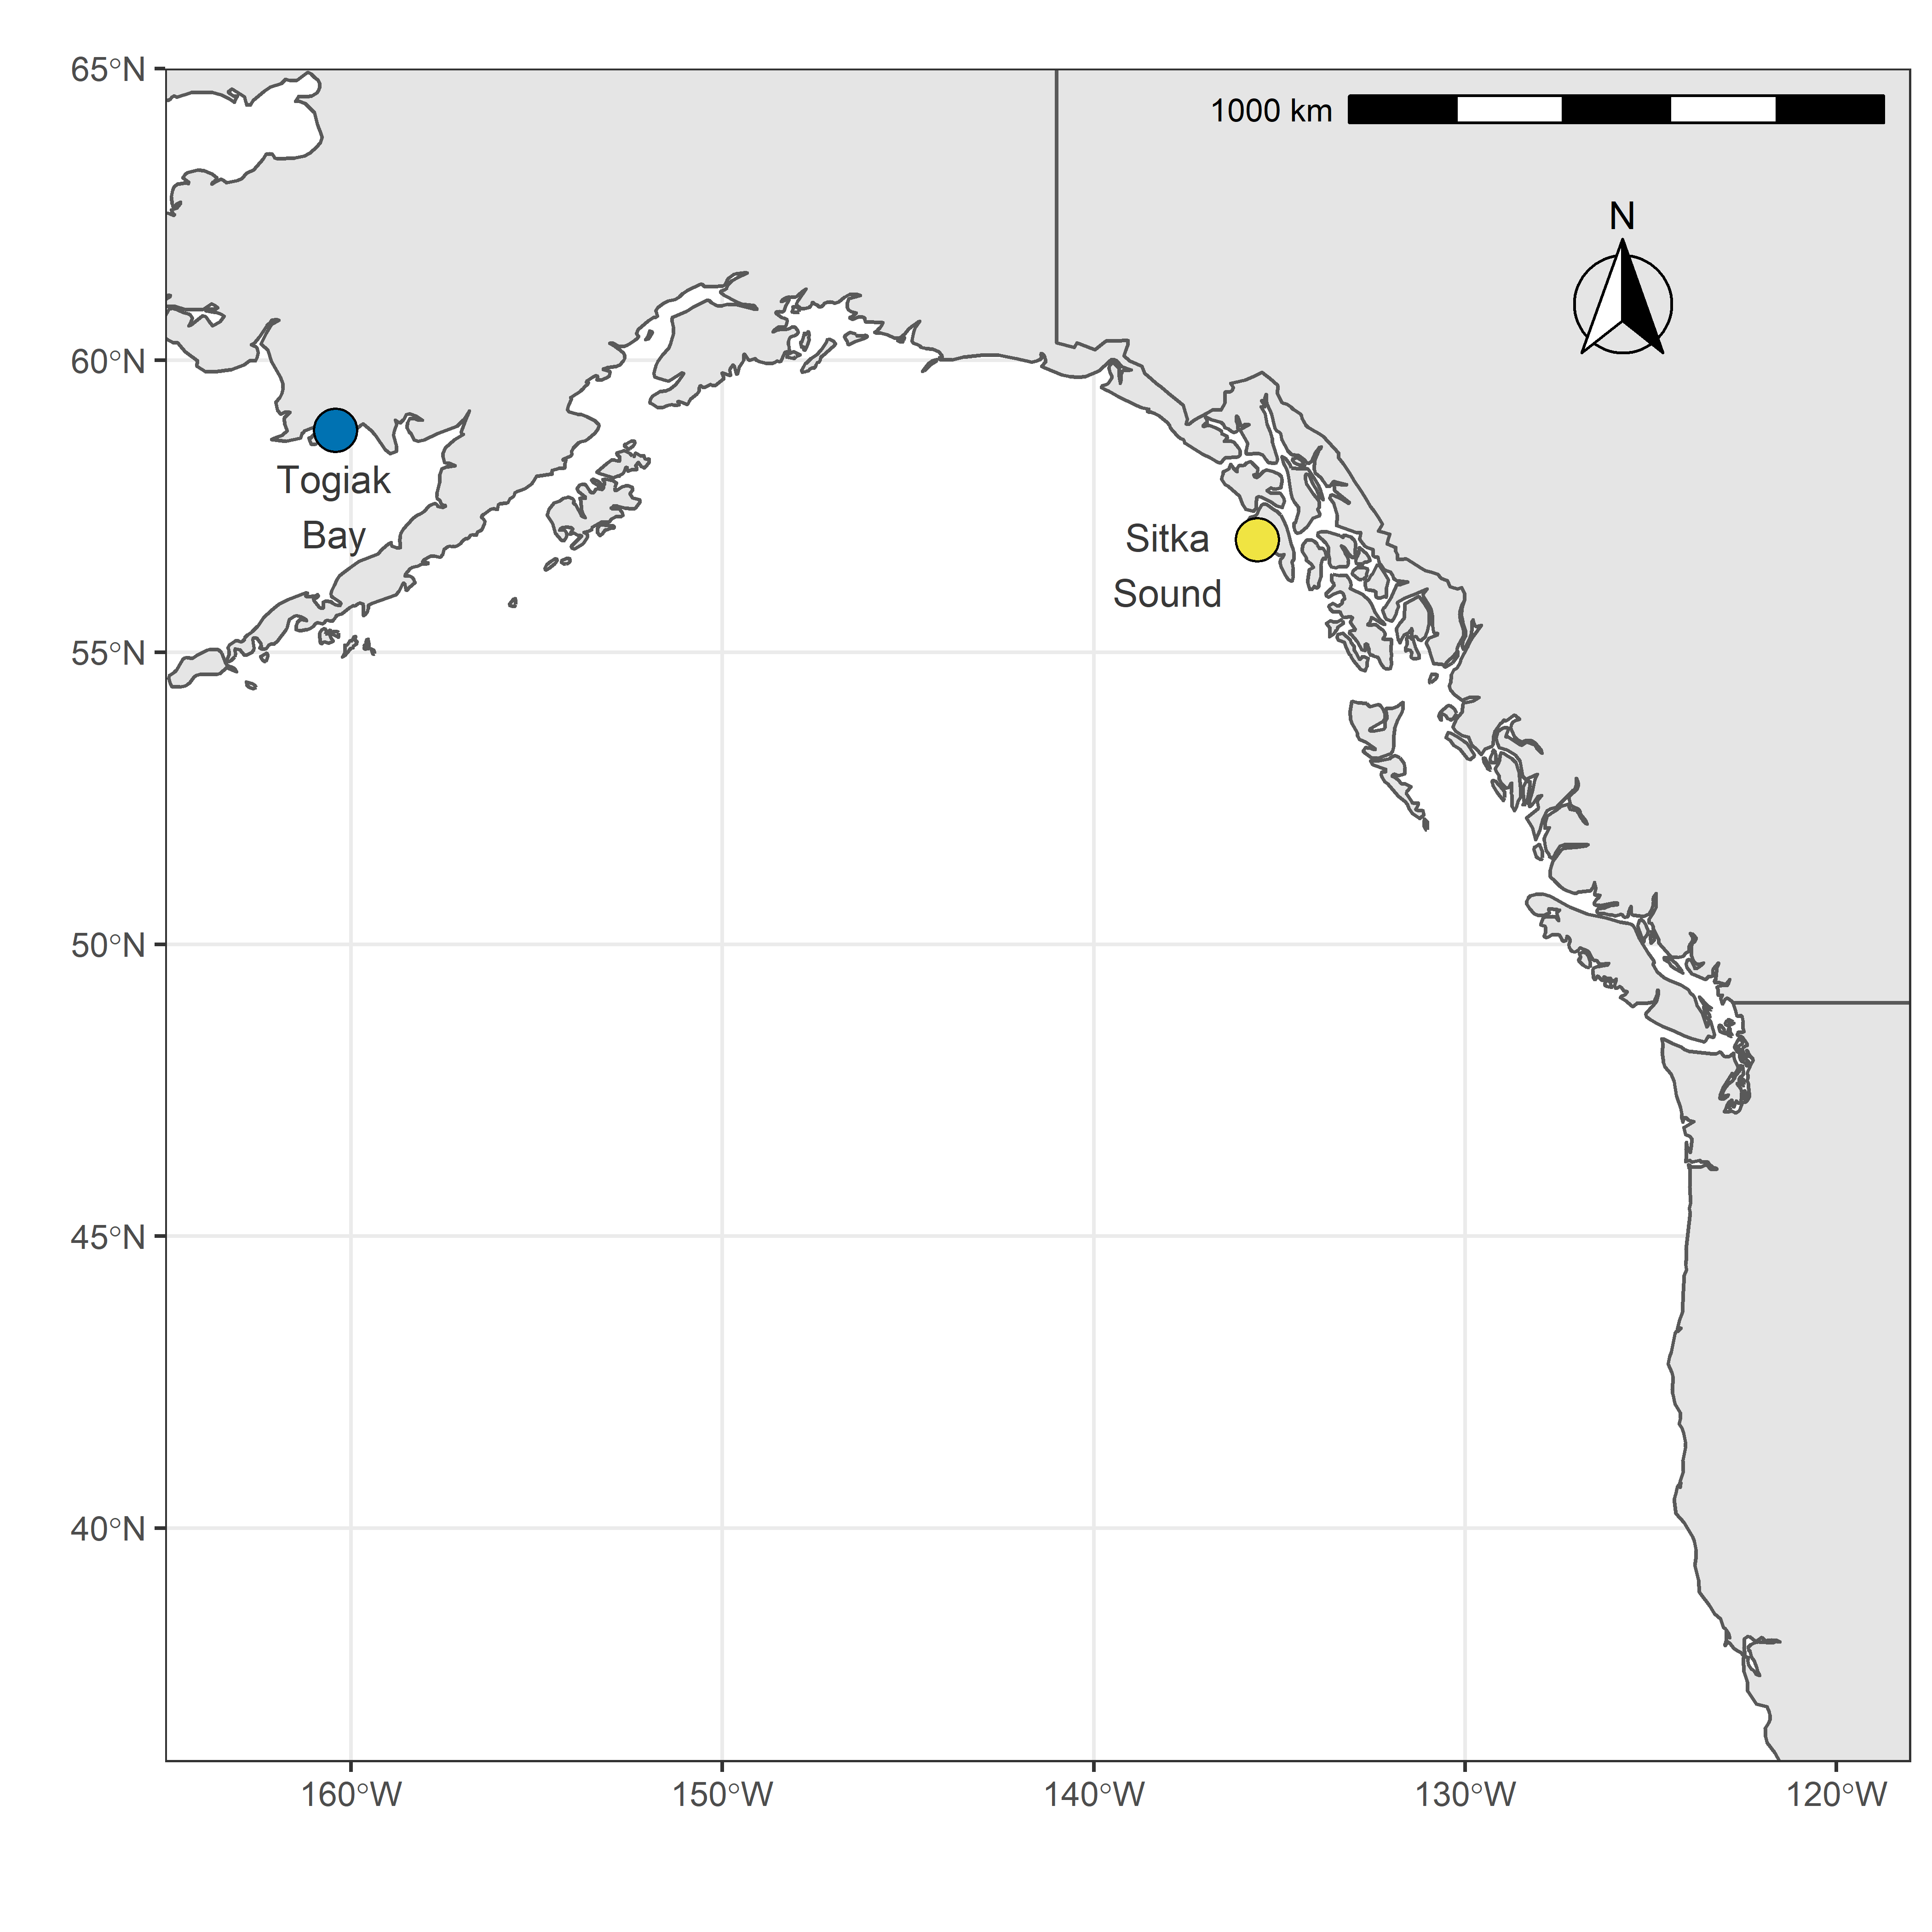
Population collapse and recovery
biomass
year
Rice and Carls 2007, EVOS Report
Notes:
Herring are a forage fish, and forage fish typically go through boom and bust population cycles, even in unstressed populations. These plots show changes in herring biomass for two populations off the coast of Alaska. You can see that population sized decreased in the early 90s and then recovered shortly after. However, this population in Prince William Sound collapsed and numbers have remained very low for the past 28 years. This collapse is exceptional across all herring populations on record, with PWS showing the most extreme collapse here. And there was a major event that likely contributed to this collapse.

Slide 10
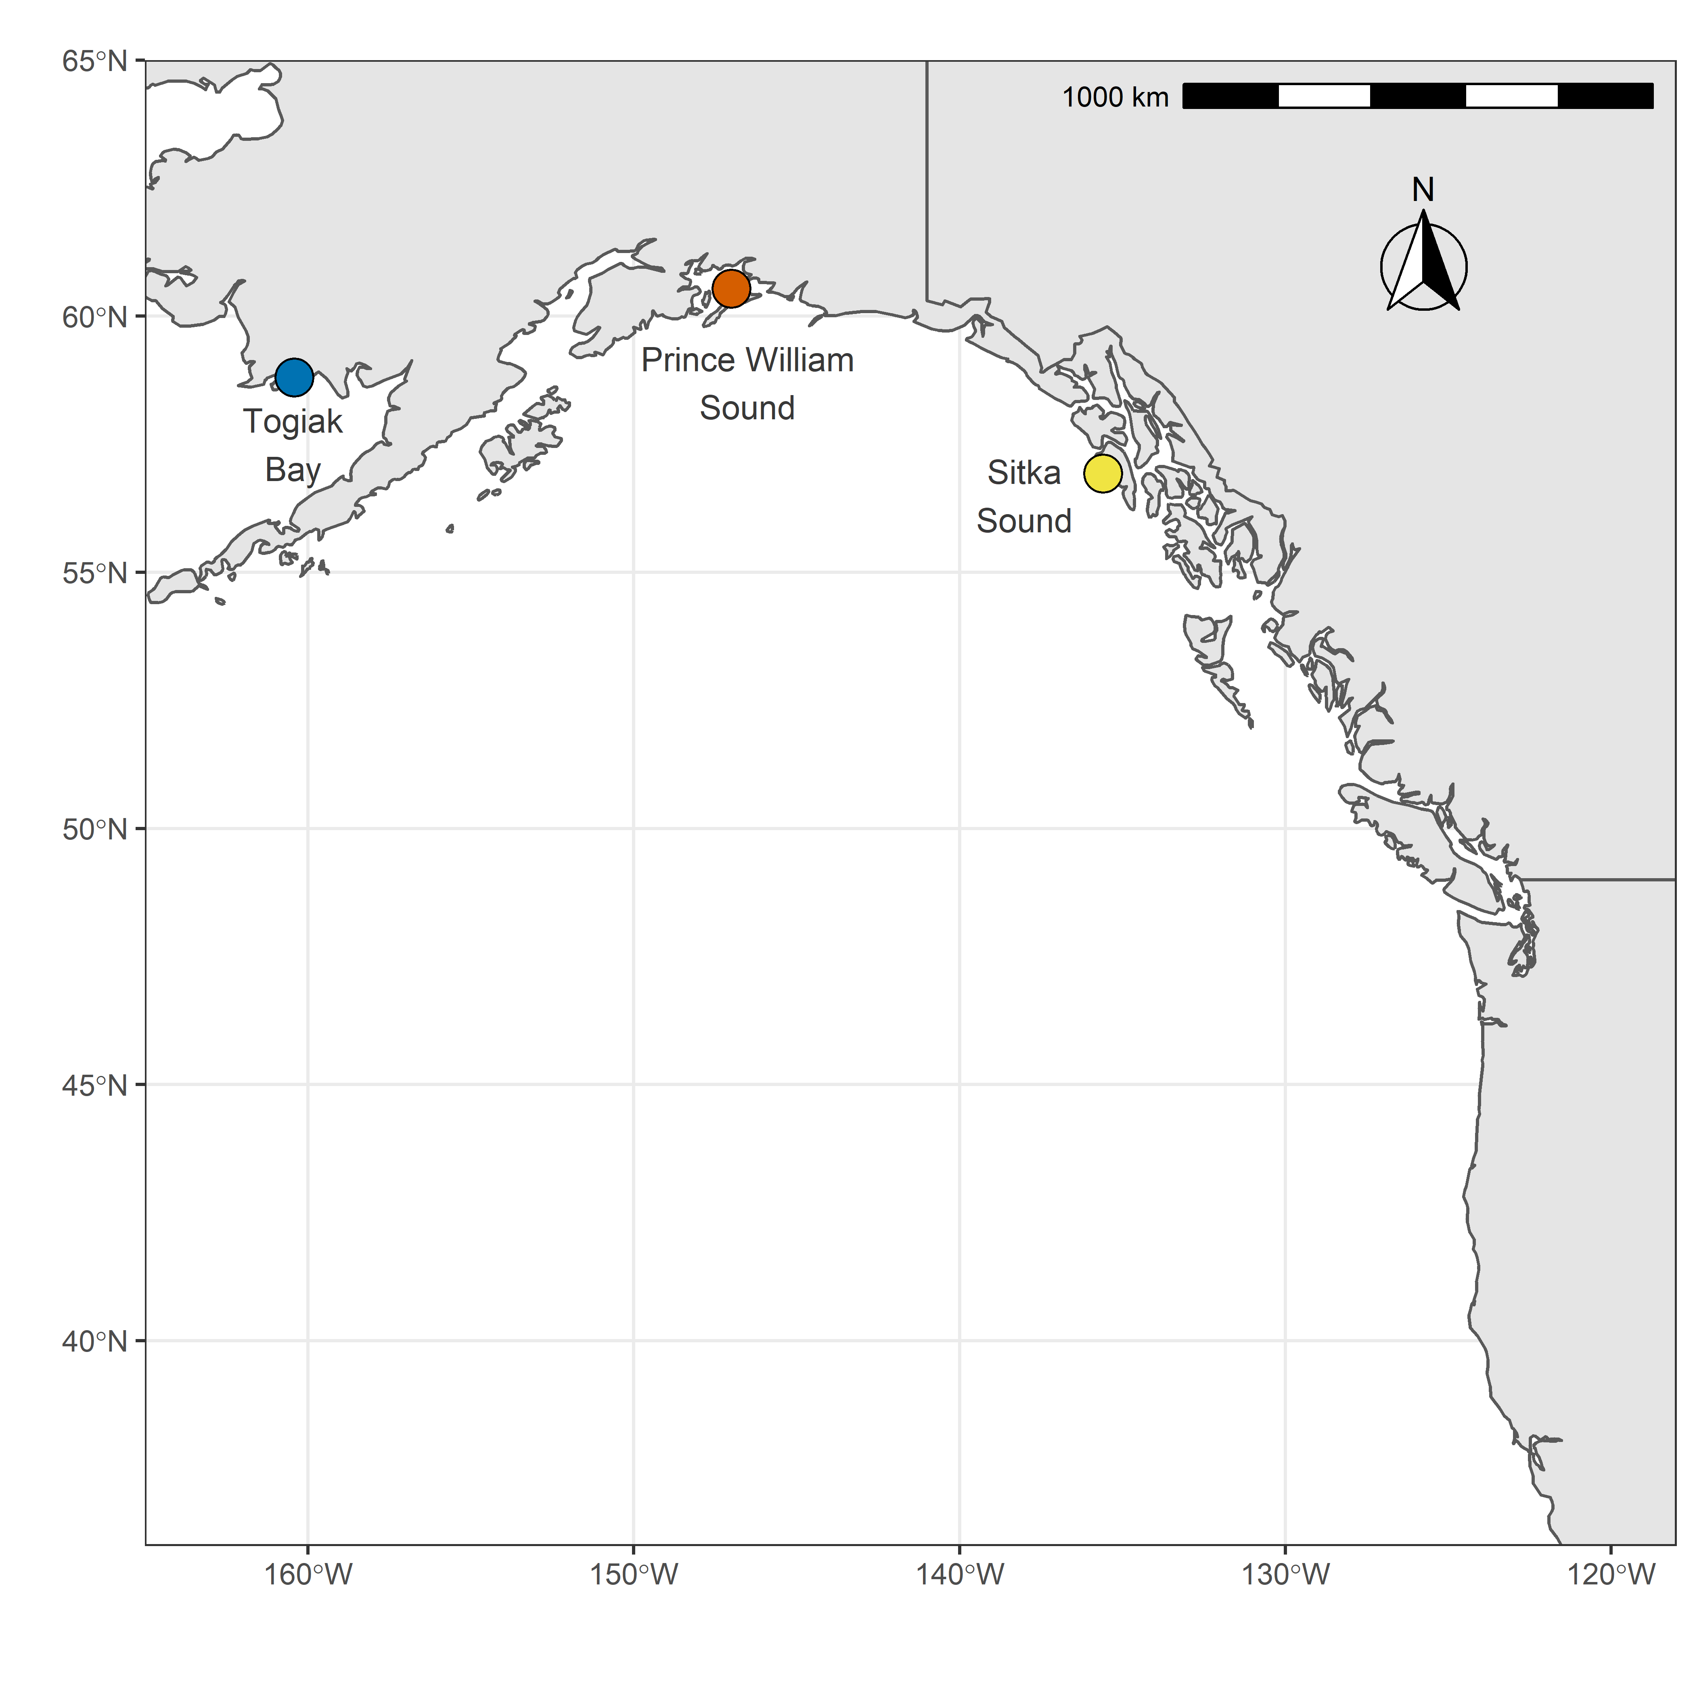
No recovery in Prince William Sound (PWS)
biomass
year
Rice and Carls 2007, EVOS Report
Notes:
Herring are a forage fish, and forage fish typically go through boom and bust population cycles, even in unstressed populations. These plots show changes in herring biomass for two populations off the coast of Alaska. You can see that population sized decreased in the early 90s and then recovered shortly after. However, this population in Prince William Sound collapsed and numbers have remained very low for the past 28 years. This collapse is exceptional across all herring populations on record, with PWS showing the most extreme collapse here. And there was a major event that likely contributed to this collapse.

Slide 11
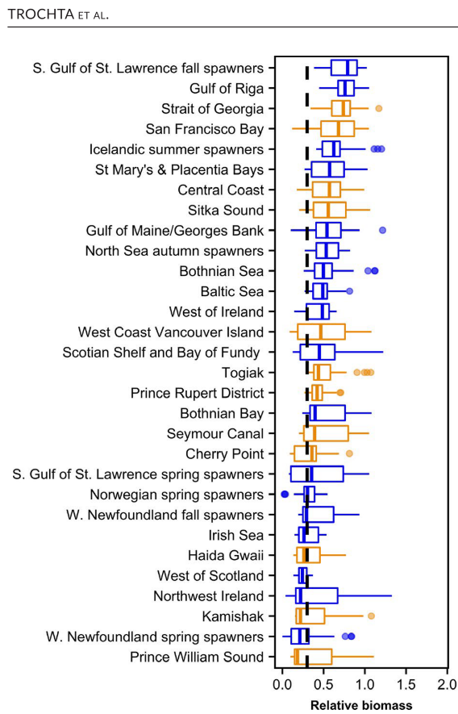
Extreme population collapse in Prince William Sound
Pacific Herring
Atlantic Herring
Trochta et al. 2020, Fish and Fisheries
Notes:
This collapse is exceptional across all herring populations on record, with PWS showing the most extreme collapse here. And there was a major event that likely contributed to this collapse.
FIGURE 2 Box plots of time-series distributions for stocks used in our analysis (at least 30 years of observations). Each time series is divided by its respective mean high value (i.e. mean of the values in the 90th percentile). Stocks are ordered by their median relative biomass from the largest median at the top to lowest median at the bottom and colour coded by species (Atlantic herring are blue and Pacific herring are orange). The 30% of Mean High Biomass and 50% of Mean High Recruit thresholds used to identify collapse levels are also shown by dashed lines in the relative biomass and relative recruits plots

Slide 12
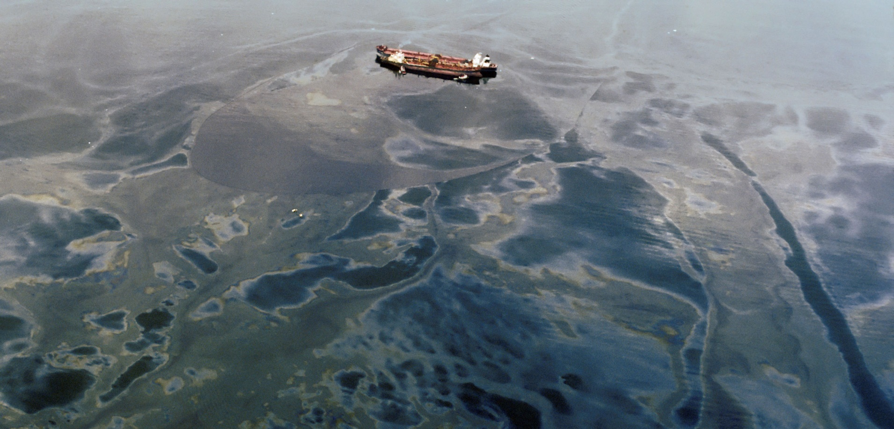
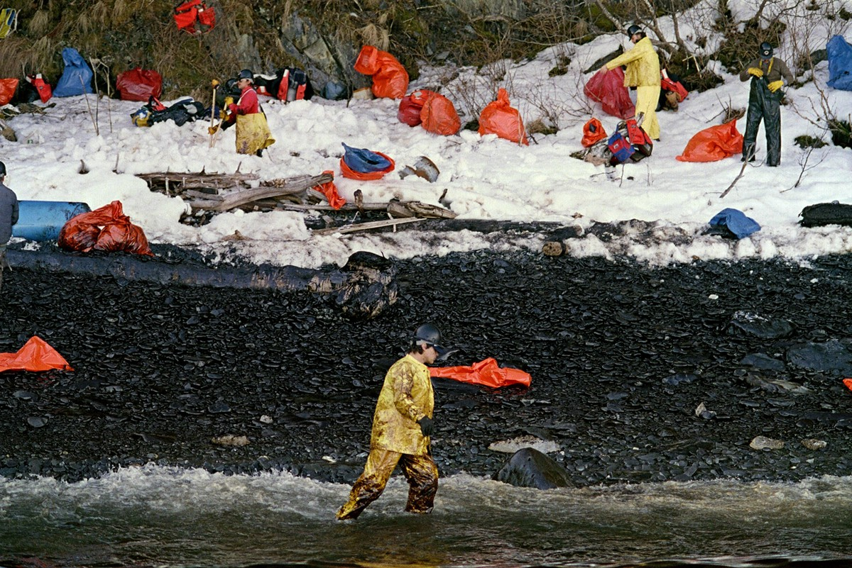
Exxon Valdez oil spill
Notes:
In the spring of 1989 the Exon Valdez oil tanker spilled 11 million gallons of crude oil into Prince William Sound. Oil covered the coastline at the height of herring spawning season, which is really bad news for herring eggs that are laid right near the shore. Like I mentioned earlier, it takes about 3-4 years for newly hatched herring to mature and join the large schools of adults in the open ocean. We can see here that just a few years after the oil spill, herring biomass dropped by 75%.

Slide 13
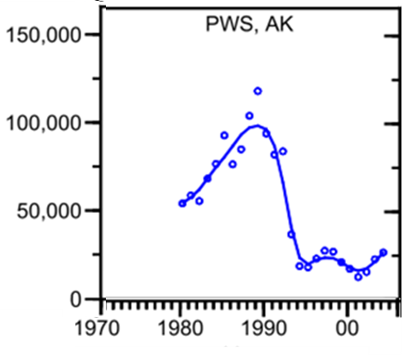
Exxon Valdez oil spill
biomass
Oil spill in 1989
Collapse in 1992
Notes:
which is really bad news for herring eggs that are laid right near the shore. Like I mentioned earlier, it takes about 3-4 years for newly hatched herring to mature and join the large schools of adults in the open ocean. We can see here that just a few years after the oil spill, herring biomass dropped by 75%. Even though it is still hotly debated to this day, it seems pretty clear that the oil spill contributed to the collapse. However, what is still a mystery is why the population hasn’t recovered after almost three decades. Every other fish population that initially declined has since recovered, so why not herring?

Slide 14
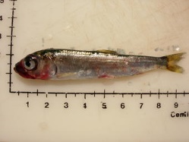
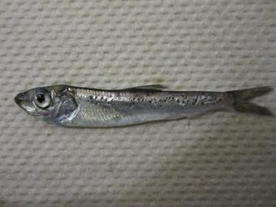
Disease: Viral hemorrhagic septicemia virus (VHSV) and Ichthyophonus hoferi (Ick)
VHSV prevalence up to 14%
Deadly at early life stages
Ichthyophonus prevalence up to 51%
Deadly at later life stages
Marty et al. 2010, Diseases of Aquatic Organisms
Photos: Paul Hershberger
Notes:
Well, one thing we know is that herring have been struggling with disease outbreaks. There are two main pathogens causing issues, Viral hemorrhagic septicemia (VHSV) and Ichthyophonus hoferi (fittingly referred to as Ick). These pathogens have plagued the population since just after the oil spill. But these pathogens are not unique to Prince William Sound. Other nearby populations have likely been dealing with them for just as long. Given that the oil spill was unique to Prince William sound, we think there’s an interaction here between disease and oil exposure.

Slide 15
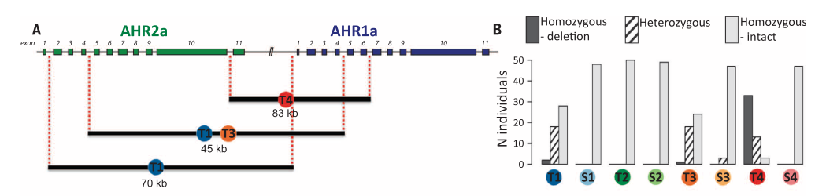
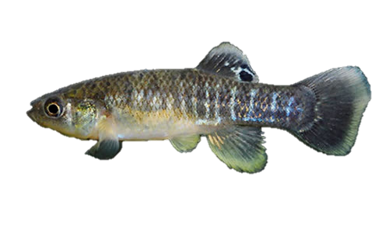
Adaptation to pollution through loss-of-function mutations
Reid et al. 2016, Science
Notes:
One of the ways we are thinking about this interaction comes from previous work with Atlantic killifish populations that have adapted to highly polluted waters in the Northeast United States. In this figure, populations are labeled T if they are pollution tolerant and labeled S if they are sensitive to pollution, measured by survival across a range of experimental exposures to polychlorinated biphenyl (PCB) concentrations, a compound that is often formed as waste in industrial processes. Tolerant populations were found to have large deletions spanning genes that are part of the aryl hydrocarbon receptor pathway. These deletions likely desensitize these populations to pollution exposure, but the fact that these deletions are rarely found in sensitive populations suggest there might be a trade-off. AHR signaling has diverse functions and interacts with multiple pathways, including estrogen and hypoxia signaling, regulation of cell cycle, and, importantly, immune system function. Overall this work shows that rapid adaptation to pollutants can favor loss-of-function variants that impair the function of signaling pathways important for healthy immune systems.

Slide 16
Increased mutation load following population collapse
Mutation load: a measure largely determined by a reduction in fitness contributed by deleterious mutations across the entire genome.
A bottleneck can increase mutation load because drift is stronger.
A bottleneck can cause larger increases in the total load when population size recovers slowly.
Lohr and Hagg 2015, Evolution. Kirkpatrick and Jarne 2000, The American Naturalist
Notes:
Another way we are thinking about population recovery is related to mutation load, which we can think about as a measure largely determined by a reduction in fitness contributed by deleterious mutations across the entire genome. Bottlenecks can increase mutation load because drift is stronger, and bottlenecks cause larger increases in mutation load when population size recovers slowly, like we see in Prince William Sound.

Slide 17
Are there genetic factors limiting population recovery in Prince William Sound?
Notes:
So keeping all of this in mind, I want to test a number of different hypotheses that are all related to this main question: Are there genetic factors limiting population recovery in Prince William Sound?

Slide 18
Low coverage sequencing of 1100 Pacific herring to identify genetic variation limiting population recovery
whole genome sequencing
QC and filtering
(trim galore, FastQC,multiQC)
align to reference
(BWA)
call variants
(GATK)
population structure
(PCAngsd, PLINK, NGSadmix)
identify loss-of-function
(ENSEMBL VEP)
short-term Ne temporal covariance
(cvtk)
Notes:
To get at this question, we have low coverage sequencing for 1100 Pacific herring. This is our pipeline to identify genetic variation limiting population recovery. I want to give a couple of quick acknowledgements. All libraries were prepared by Jenn Roach and Elias Oziolor before I joined the lab. This was a ton of work, with over 20 plates of DNA sequenced. I also want to thank Vince Buffalo for analyses he performed using his cvtk workflow.

Slide 19


Acknowledgements
whole genome sequencing
Libraries prepared by Jenn Roach and Elias Oziolor
QC and filtering
(trim galore, FastQC, multiQC)
align to reference
(BWA)
call variants
(GATK)
population structure
(PCAngsd, PLINK, NGSadmix)
identify loss-of-function
(ENSEMBL VEP)
short-term Ne temporal covariance
(cvtk)
Notes:
To get at this question, we have low coverage sequencing for 1100 Pacific herring. This is our pipeline to identify genetic variation limiting population recovery. I want to give a couple of quick acknowledgements. All libraries were prepared by Jenn Roach and Elias Oziolor before I joined the lab. This was a ton of work, with over 20 plates of DNA sequenced. I also want to thank Vince Buffalo for analyses he performed using his cvtk workflow.

Slide 20
Acknowledgements
whole genome sequencing
QC and filtering
(trim galore, FastQC, multiQC)
align to reference
(BWA)
call variants
(GATK)
population structure
(PCAngsd, PLINK, NGSadmix)
identify loss-of-function
(ENSEMBL VEP)
short-term Ne temporal covariance
(cvtk)
Vince Buffalo
Notes:
To get at this question, we have low coverage sequencing for 1100 Pacific herring. This is our pipeline to identify genetic variation limiting population recovery. I want to give a couple of quick acknowledgements. All libraries were prepared by Jenn Roach and Elias Oziolor before I joined the lab. This was a ton of work, with over 20 plates of DNA sequenced. I also want to thank Vince Buffalo for analyses he performed using his cvtk workflow.

Slide 21
1100 herring genomes (1.2x)
whole genome sequencing of 1100 samples
VCF filters
coverage | between 600 and 2000
base quality | >20
mapping quality | >30
minor allele freq. | >5%
genotyping rate | >50%
QC and filtering
(trim galore, FastQC,multiQC)
align to reference
(BWA)
call variants
(GATK)
population structure
(ANGSD)
200,000 SNPs
identify loss-of-function
(ENSEMBL VEP)
short-term Ne temporal covariance
(cvtk)
Notes:
So we have low coverage sequencing about 1x coverage. I ran sequences through this variant calling pipeline to calculate genotype likelihoods, and used these filters to generate a final data set including 200000 SNPs.

Slide 22
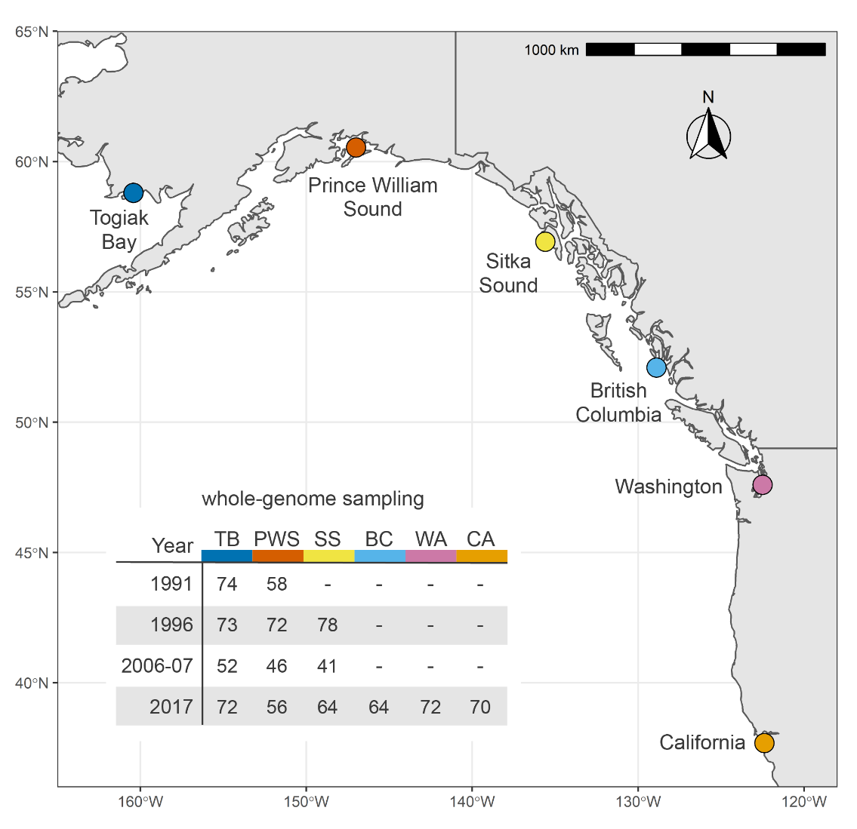
Population sampling
None of the pre-collapse samples collected in 1991 were exposed to oil as embryos.
A subset of the post-collapse samples collected in 1996 descended from oil spill survivors.
None of the post-collapse samples collected in 2007 and 2017 were directly exposed to oil.
Notes:
Here are the sample sizes we are working with. In red is Prince William Sound where the oil spill occurred, and for Togiak Bay in blue, we have samples from 1991,1996,2006, and 2017. All samples come from adults, this means that READ. This sampling strategy gives us the ability to compare allele frequencies pre, and post oil spill. We can think of Togiak bay as our healthy reference population that was never exposed to oil and maintains a healthy population size. We also have samples that span the Pacific coast from Alaska to California, although most populations were sampled at a single time point in 2017.

Slide 23
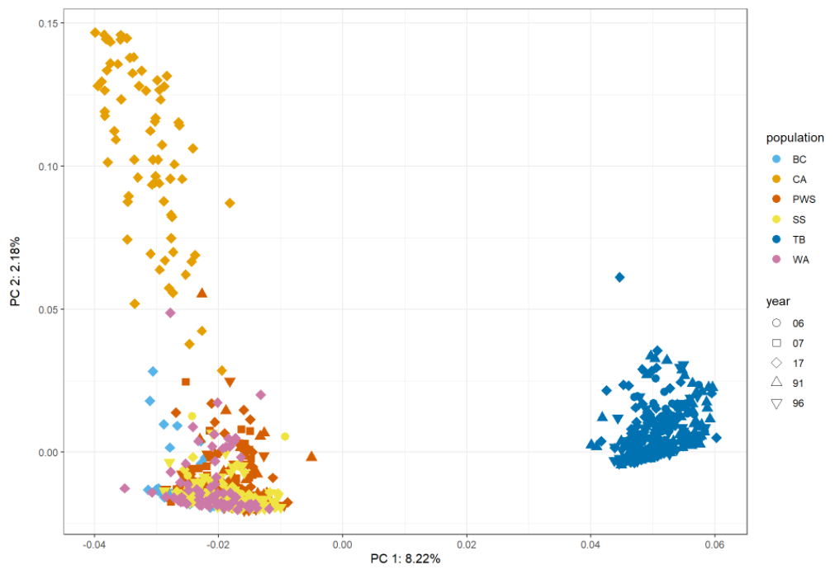
Population structure
PC2: 2.18%
PC1: 8.22%
Notes:
Here is what population structure looks like, with the Togiak bay population separating from the NorthEast Pacific populations on PC1 and the California population separating out on PC2.

Slide 24
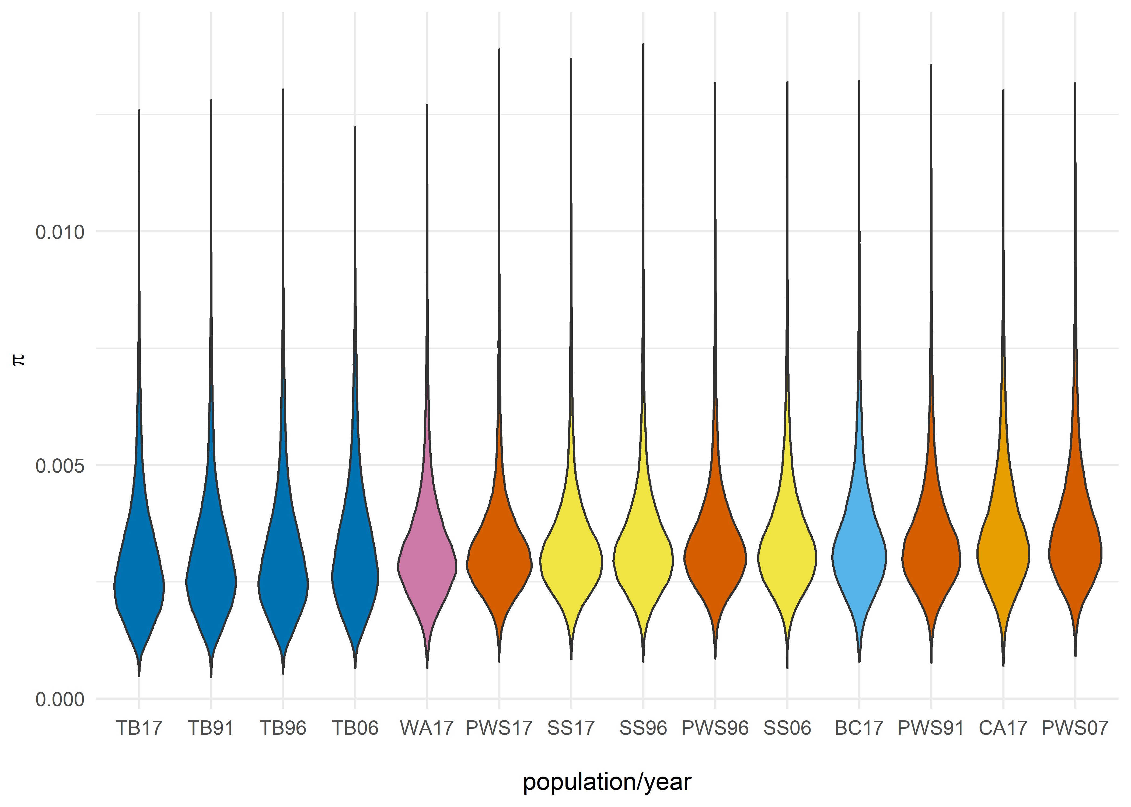
Nucleotide Diversity
π
Notes:
Here is what the distribution of pairwise nucleotide diversity looks like across populations. Similar to what is seen in Atlantic herring with average pi around .002 to .003. The Togiak bay population shows the lowest levels of nucleotide diversity. The rest of the populations are pretty similar.

Slide 25
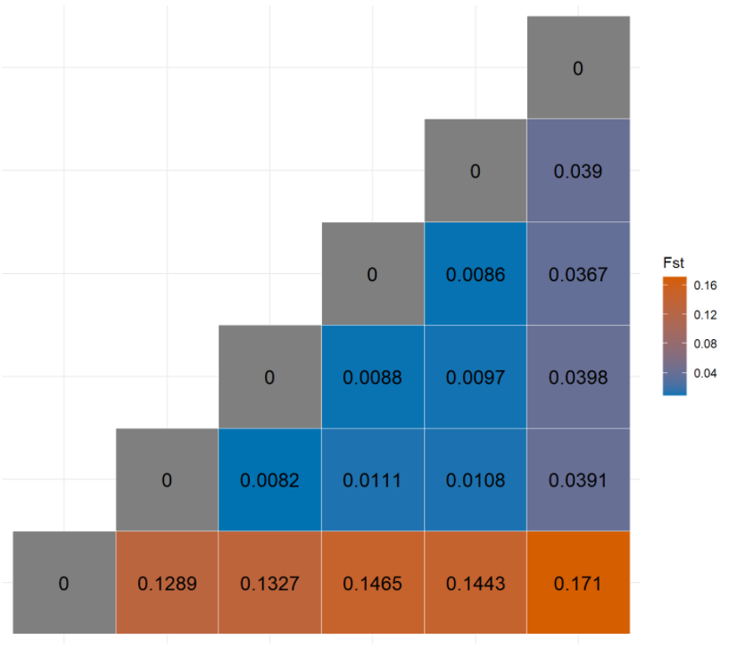
Fst: 2017 comparisons
CA
WA
BC
SS
PWS
TB
TB
PWS
SS
BC
WA
CA
Notes:
Here is what Fst looks like, and it lines up pretty well with what I showed in the PCA, with the Togiak Bay population being the most divergent, followed by the California population, and then we see very little structure among NorthEast Pacific populations. Ok, so those are just a couple of genome-wide summary statistics to give you a sense of the data I have. Now I want to use this data to test some hypotheses.

Slide 26
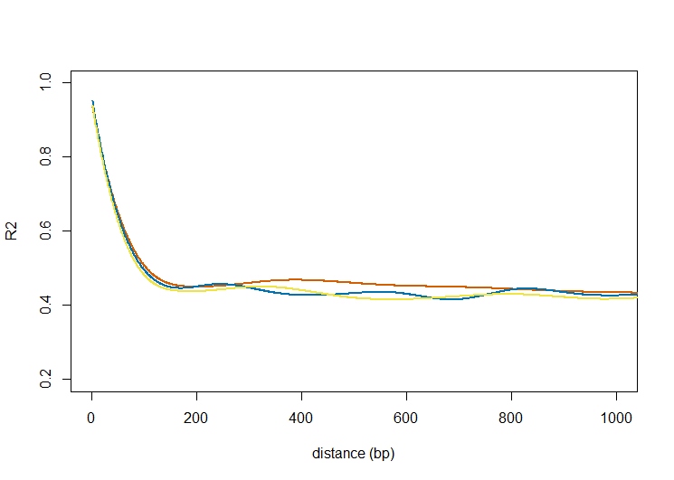
LD decay
Notes:
Linkage disequilibrium decays rapidly and at pretty much the same rate across populations, it drops off to background levels around 200bp. Ok, so those are just a few genome-wide summary statistics I wanted to show to give you a sense of the data I’m working with. Now I want to use this data to test some hypotheses.

Slide 27
Population collapse
Motivation
Half of egg biomass in 1989 was within the trajectory of spilled oil that would have occurred at harmful concentrations.
Hypothesis
PWS should show a larger decline in effective population size post-spill compared to nearby populations.
Notes:
This first one is related to population collapse. READ.

Slide 28
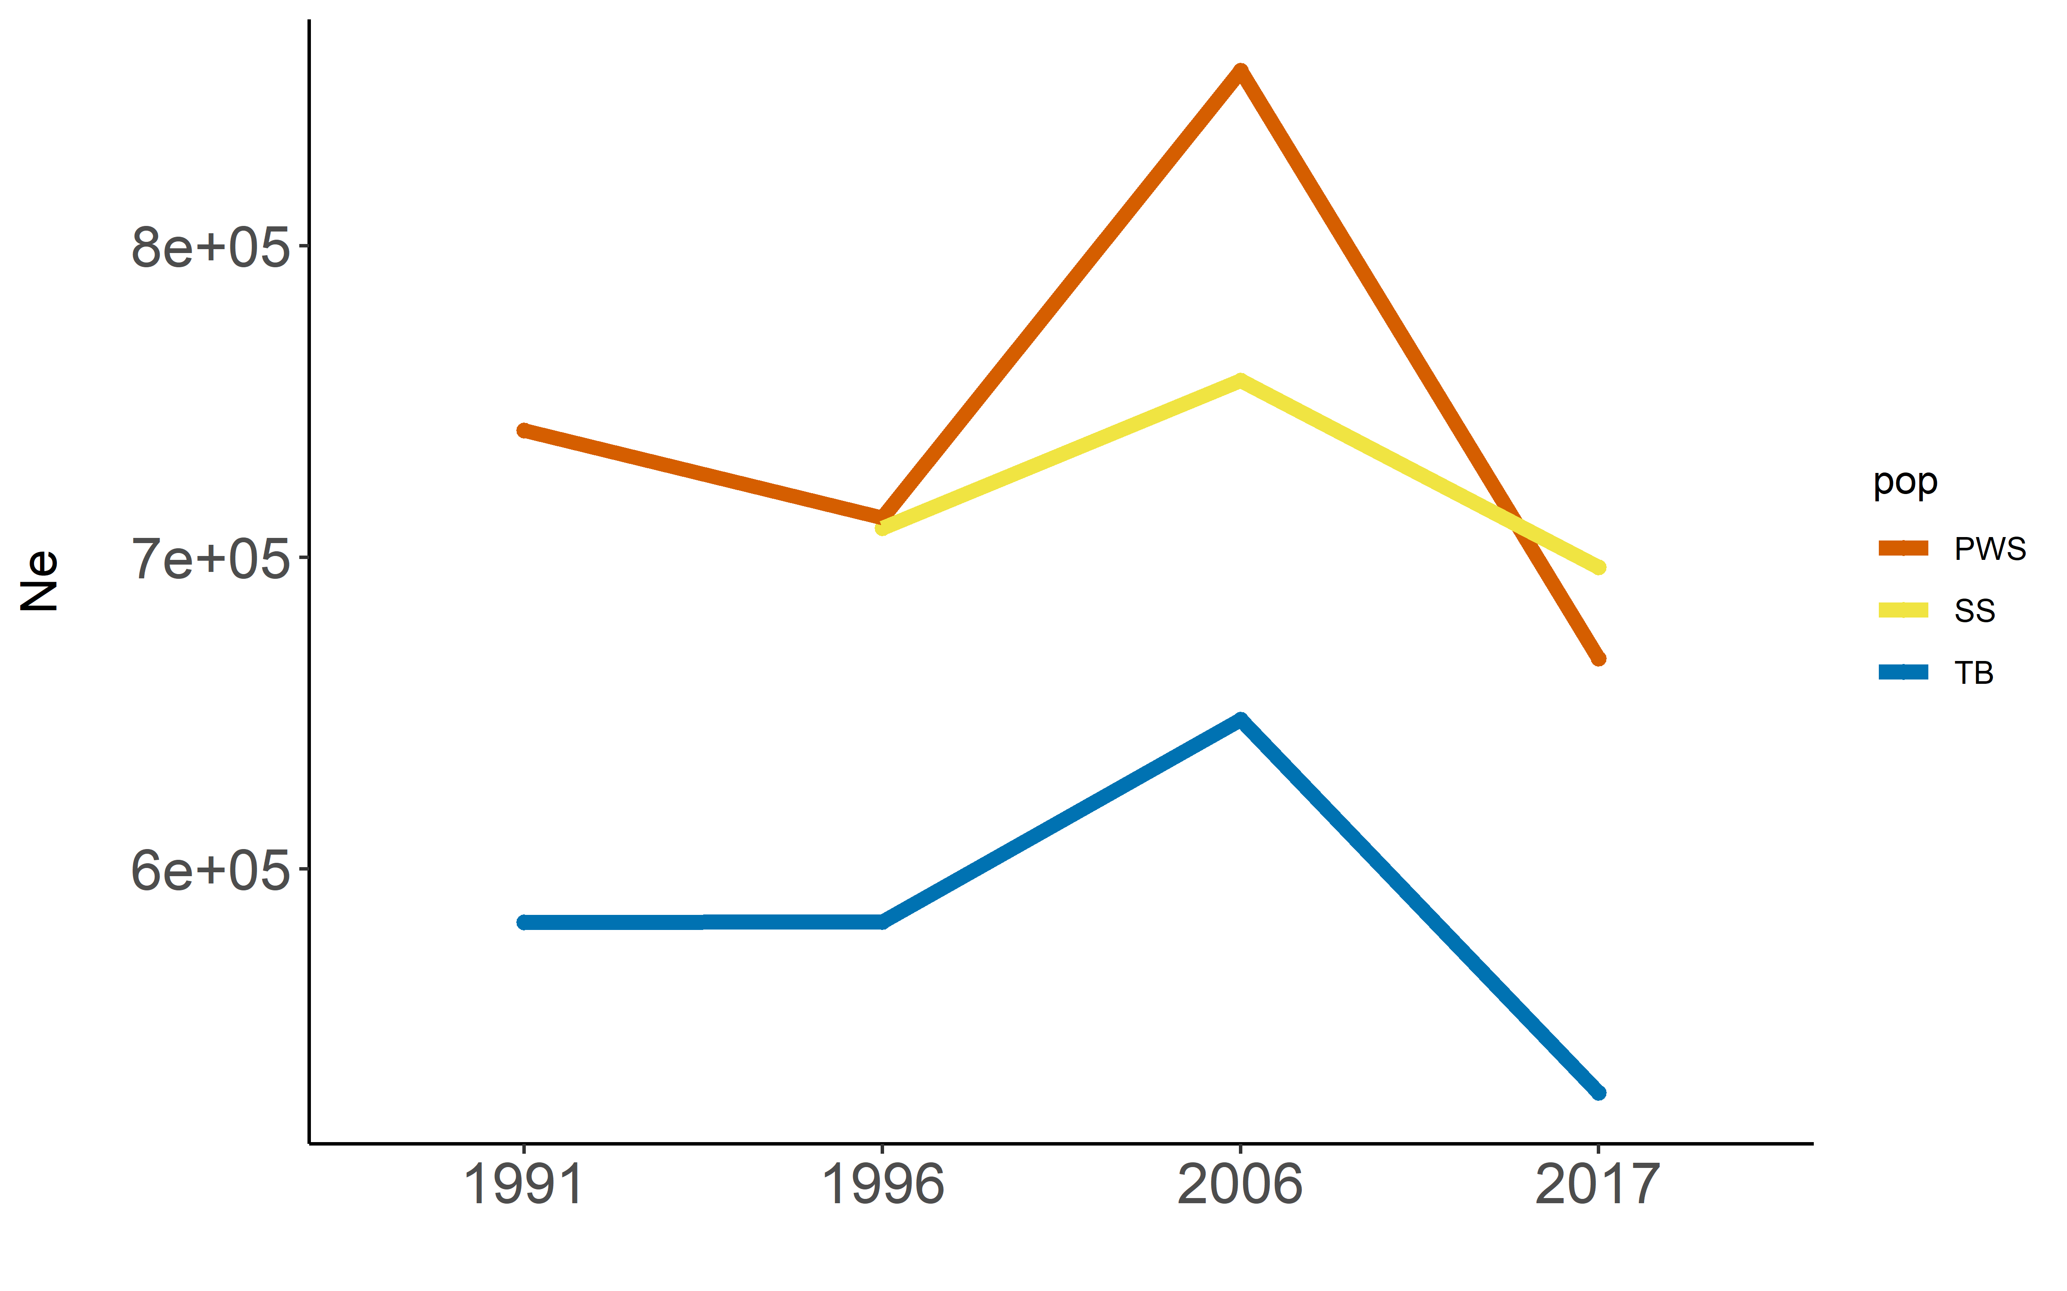
Effective population size changes through time
Ө = 4Neµ
t << Ne
Notes:
If we measure effective population size using theta = 4Nemu we see that Ne is most variable and a little higher in PWS in red compared to the nearby healthy populations in blue and yellow. However, this is a long-term measure of effective population size that is related to coalescence time in generations. If we expect that the decline in population size happened within the past few decades, the then number of generations between samples is very low, and much lower than Ne. So we shouldn’t expect to be able to see signal of a decline in Ne using this long term measure. But, We can also look at a short-term measure

Slide 29
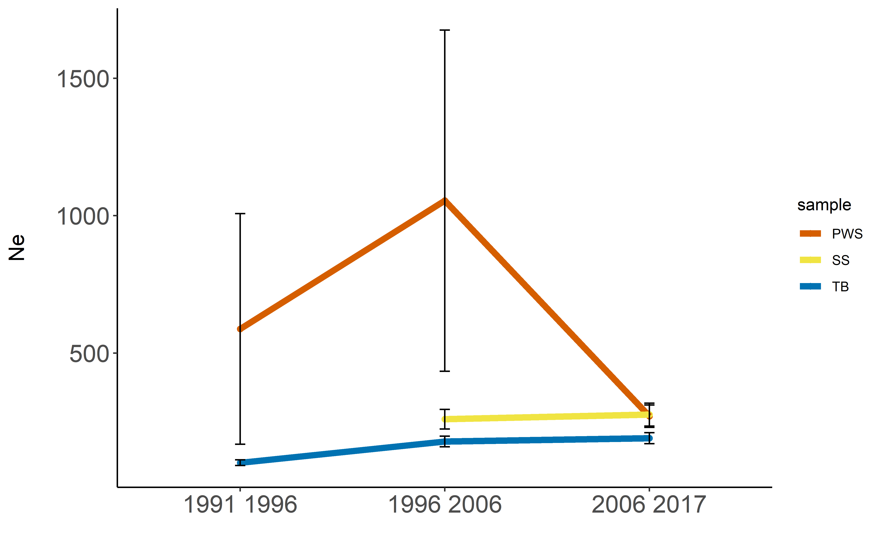
Effective population size changes through time
Ө = 4Neµ
t << Ne
variance in the temporal changes of allele frequency (F)
F ∝ 1/Ne
Notes:
But, We can also look at a short-term measure of Ne that can be estimated when you have temporal sampling across generations. We can measure the variance in temporal changes in allele frequency across sampling periods, and this measure is inversely proportional to effective population size. Using this approach, we see a relatively stable population sizes in the healthy populations in blue and yellow, but an overall decline in population size in PWS between 1991 and 2017. The contemporary effective population size in PWS is similar to the other nearby healthy populations.

Slide 30
Population collapse
Motivation
Half of egg biomass in 1989 was within the trajectory of spilled oil that would have occurred at harmful concentrations.
Hypothesis
PWS should show a larger decline in effective population size post-spill compared to nearby populations.
Notes:
So relating this back to our hypothesis, the short-term estimates of Ne suggest a decline in population size in Prince William Sound while the reference populations remained stable, and this is consistent with surveys measuring a decline in census population size in all three populations. I want to keep this in mind as I move onto hypotheses related to slow population recovery.

Slide 31
Population recovery
Motivation
PWS experienced a decline in population size.
Notes:
Given what we know about the atlantic killifish populations, rapid adaptation to pollutants can favor genetic variation that impairs the function of signaling pathways important for healthy immune systems. Specifically the AHR signaling pathway. In Pacific herring it is possible that genetic variants that conferred resistance to oil exposure immediately after the spill, came at the cost of compromised immune function. In other words, variants that helped individuals survive the oil exposure are now deleterious because they disrupt the ability to mount an effective immune response. Finally, given that those deleterious alleles increased in frequency after the oil spill.

Slide 32
Population recovery
Motivation
PWS experienced a decline in population size.
Rapid adaptation to pollutants can favor genetic variation that impairs the function of signaling pathways important for healthy immune systems.
Notes:
Given what we know about the atlantic killifish populations, rapid adaptation to pollutants can favor genetic variation that impairs the function of signaling pathways important for healthy immune systems. Specifically the AHR signaling pathway. In Pacific herring it is possible that genetic variants that conferred resistance to oil exposure immediately after the spill, came at the cost of compromised immune function. In other words, variants that helped individuals survive the oil exposure are now deleterious because they disrupt the ability to mount an effective immune response. Finally, given that those deleterious alleles increased in frequency after the oil spill.

Slide 33
Population recovery
Motivation
PWS experienced a decline in population size.
Rapid adaptation to pollutants can favor genetic variation that impairs the function of signaling pathways important for healthy immune systems.
Hypotheses
Genetic variation was favored that conferred resistance to oil exposure immediately after the spill. The same variation is now deleterious because it affects proper immune function.
PWS may show a higher frequency of deleterious alleles post-spill.
Notes:
Given what we know about the atlantic killifish populations, rapid adaptation to pollutants can favor genetic variation that impairs the function of signaling pathways important for healthy immune systems. Specifically the AHR signaling pathway. In Pacific herring it is possible that genetic variants that conferred resistance to oil exposure immediately after the spill, came at the cost of compromised immune function. In other words, variants that helped individuals survive the oil exposure are now deleterious because they disrupt the ability to mount an effective immune response. Finally, given that those deleterious alleles increased in frequency after the oil spill.

Slide 34

Are loss-of-function alleles more common after the oil spill?
input .bed file with Ref and Alt alleles
Ensembl Variant Effect Predictor
Notes:
To test this I characterized loss of function alleles within each population using an Ensembl tool called variant effect predictor. I am assuming that particular loss-of-function alleles are deleterious because they are predicted to disrupt gene function. I input a bed file with reference and alternate alleles, and the tool searches across 24000 genes that are annotated for the atlantic herring reference genome, and reports how many of my alleles would cause different categories of coding mutations. Here I’m showing the number of stop gained, stop lost, and start lost mutations that would likely disrupt gene function.

Slide 35
Are loss-of-function alleles more common after the oil spill?
input .bed file with Ref and Alt alleles
Ensembl Variant Effect Predictor
Atlantic herring reference genome
24,095 coding genes
Notes:
To test this I characterized loss of function alleles within each population using an Ensembl tool called variant effect predictor. I am assuming that particular loss-of-function alleles are deleterious because they are predicted to disrupt gene function. I input a bed file with reference and alternate alleles, and the tool searches across 24000 genes that are annotated for the atlantic herring reference genome, and reports how many of my alleles would cause different categories of coding mutations. Here I’m showing the number of stop gained, stop lost, and start lost mutations that would likely disrupt gene function.

Slide 36
Are loss-of-function alleles more common after the oil spill?
input .bed file with Ref and Alt alleles
Ensembl Variant Effect Predictor
Atlantic herring reference genome
24,095 coding genes
stop gained | 190
stop lost | 40
start lost | 30
Notes:
To test this I characterized loss of function alleles within each population using an Ensembl tool called variant effect predictor. I am assuming that particular loss-of-function alleles are deleterious because they are predicted to disrupt gene function. I input a bed file with reference and alternate alleles, and the tool searches across 24000 genes that are annotated for the atlantic herring reference genome, and reports how many of my alleles would cause different categories of coding mutations. Here I’m showing the number of stop gained, stop lost, and start lost mutations that would likely disrupt gene function.

Slide 37
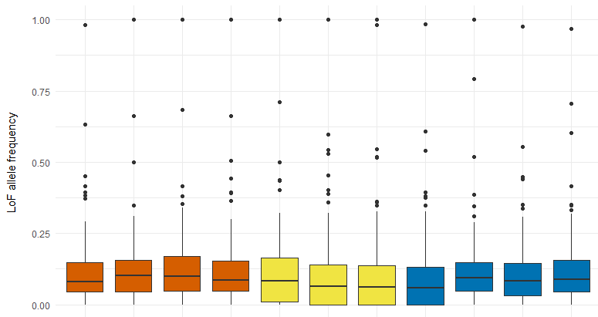
Frequency of loss-of-function alleles across populations
P = 0.895
ANOVA, P = 0.963
LOF allele frequency
91 96 06 17 96 06 17 91 96 06 17
year
Notes:
Here I’m showing the allele frequencies for each of these predicted mutations across all populations. As you can see, there wasn’t much difference between populations, particularly between PWS and nearby healthy populations in blue and yellow. Furthermore, there wasn’t a big difference between pre- and post- oil spill samples in prince William sound. So relating this back to our hypothesis,

Slide 38
Population recovery
Motivation
PWS experienced a decline in population size.
Rapid adaptation to pollutants can favor genetic variation that impairs the function of signaling pathways important for healthy immune systems.
Hypotheses
Genetic variation was favored that conferred resistance to oil exposure immediately after the spill. The same variation is now deleterious because it affects proper immune function.
PWS may show a higher frequency of deleterious alleles post-spill.
Notes:
So relating this back to our hypothesis, these results do not suggest that population recovery is limited by an overall increase in mutation load. In other words, we don’t see a general increase in the frequency of deleterious alleles in Prince William Sound. However, what if instead of an overall increase in deleterious mutations, there are very specific mutations that are important, like we see in the killifish system? If a gene is important for surviving oil exposure and disease exposure as we predict, then that gene region should show signs of fluctuating selection.

Slide 39
Population recovery
Motivation
PWS experienced a decline in population size.
Rapid adaptation to pollutants can favor genetic variation that impairs the function of signaling pathways important for healthy immune systems.
Hypotheses
Genetic variation was favored that conferred resistance to oil exposure immediately after the spill. The same variation is now deleterious because it affects proper immune function.
PWS may show a higher frequency of deleterious alleles post-spill.
PWS may show genetic signatures of fluctuating selection pressures.

Slide 40


Population recovery
Motivation
PWS experienced a decline in population size.
Rapid adaptation to pollutants can favor genetic variation that impairs the function of signaling pathways important for healthy immune systems.
Hypotheses
Genetic variation was favored that conferred resistance to oil exposure immediately after the spill. The same variation is now deleterious because it affects proper immune function.
PWS may show a higher frequency of deleterious alleles post-spill.
PWS may show genetic signatures of fluctuating selection pressures.
1991-1996
1996-2017
Notes:
The key to this hypothesis is that selection pressures in PWS changed from oil exposure to disease exposure, while selection pressures were presumably more stable in nearby populations. So next I wanted to look for regions of the genome that showed shifts in allele frequencies consistent with this change in selection pressures. In other words, I want to look for regions of the genome where allele frequency shifts changed direction, and I’m going to do that by measuring this delta Z statistic across genomic windows.

Slide 41
Measuring temporal shifts in allele frequency to identify fluctuating selection
year | major allele frequency p | minor allele frequency q
1991 | 0.9 | 0.1
1996 | 0.7 | 0.3
2006 | 0.9 | 0.1
Δz = arcsine ( q_{t1}) - arcsine ( q_{t0})
Notes:
In other words, I want to look for regions of the genome where allele frequency shifts changed direction, and I’m going to do that by measuring this delta Z statistic across genomic windows. So for example, if there was this minor allele that increased in frequency between 1991 and 1996, and then decreased again between 1996 and 2006, we would see a positive delta z in this comparison and a negative delta z in the later comparison.

Slide 42
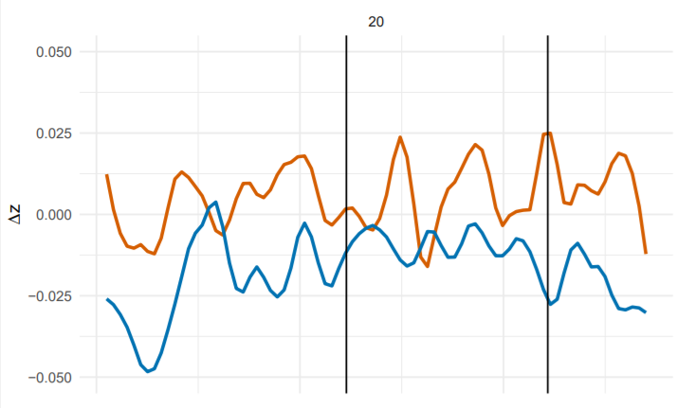
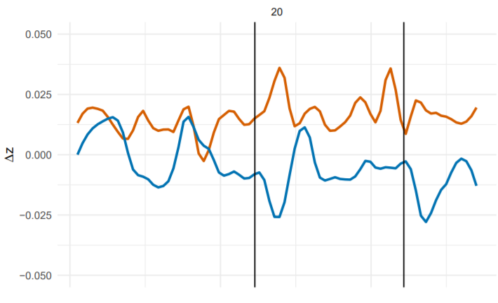
Temporal shifts in allele frequency near AHR signaling genes Prince William Sound and Togiak Bay
1991-1996
1996-2006
aip
arnt
aip
arnt
chr 20 (27mb)
Notes:
Since AHR signaling genes were important in the Killifish system, I first looked for frequency shifts at those genes. These are two genes in that pathway, aip and arnt, and we can see that minor allele frequencies increased between 1991 and 1996 around the arnt gene in Prince William Sound, but decreased in the healthy Togiak Bay population. Then between 1996 and 2006 we see that allele frequencies changed less drastically in both populations. So these are just two genes on chromosome 20. If we zoom out and look at allele frequency shifts genome wide between 1991 and 1996, we see these two huuuuge dips on chr 7 and 12. Then if we look between 1996 and 2006, we see a reversal in the direction of allele frequency change. Now I’ll zoom in on this chromosome, chromosome 7. We see shifts in the healthy Togiak bay population in blue too, but we see that the reversal only occurs in PWS.

Slide 43
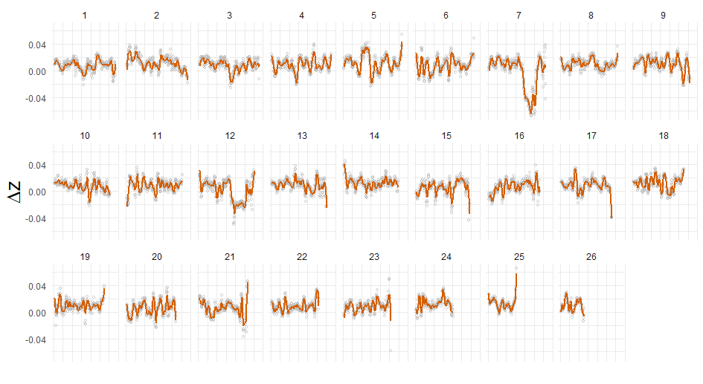
Temporal shifts in allele frequency between 1991 and 1996 Prince William Sound
1MB windows
Notes:
If we zoom out and look at allele frequency shifts genome wide between 1991 and 1996, we see these two huuuuge dips on chr 7 and 12. Then if we look between 1996 and 2006, we see a reversal in the direction of allele frequency change. Now I’ll zoom in on this chromosome, chromosome 7. We see shifts in the healthy Togiak bay population in blue too, but we see that the reversal only occurs in PWS.

Slide 44
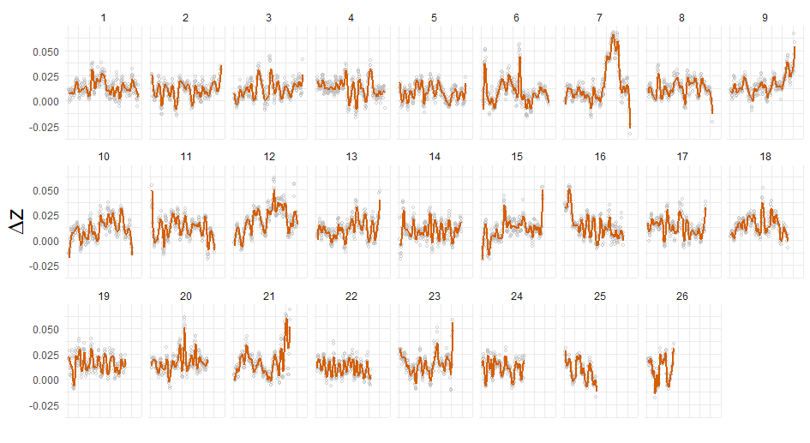
Temporal shifts in allele frequency between 1996 and 2006 Prince William Sound
1MB windows
Notes:
If we zoom out and look at allele frequency shifts genome wide between 1991 and 1996, we see these two huuuuge dips on chr 7 and 12. Then if we look between 1996 and 2006, we see a reversal in the direction of allele frequency change. Now I’ll zoom in on this chromosome, chromosome 7. We see shifts in the healthy Togiak bay population in blue too, but we see that the reversal only occurs in PWS.

Slide 45
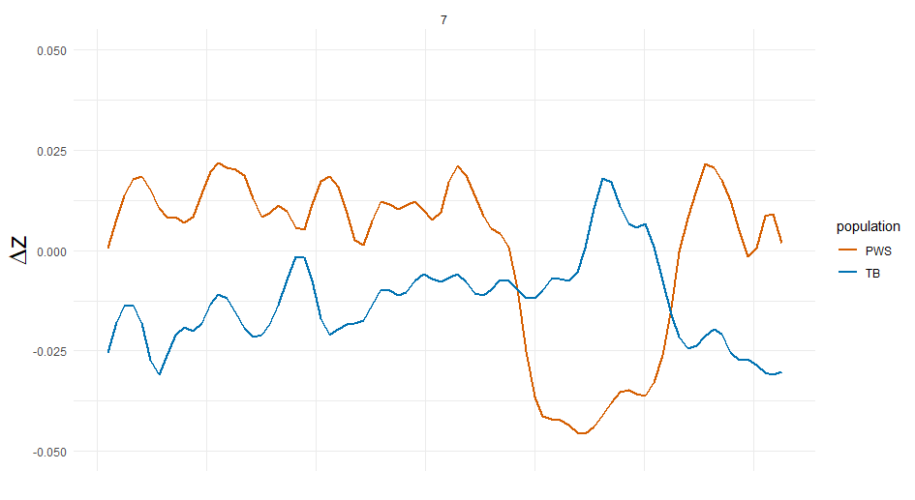
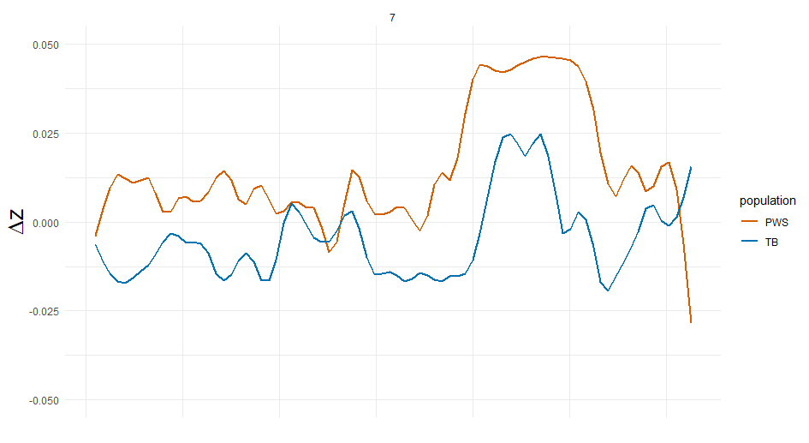
Fluctuating selection in Prince William Sound? Prince William Sound and Togiak Bay
1991-1996
1996-2006
chr 7 (30mb)
Notes:
We see significant shifts in the healthy Togiak bay population in blue too, but we see that the reversal only occurs in PWS.

Slide 46
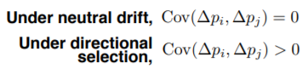
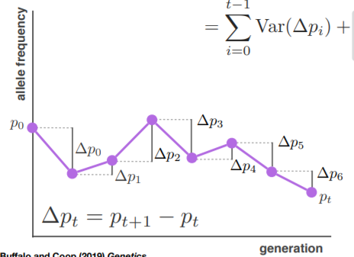
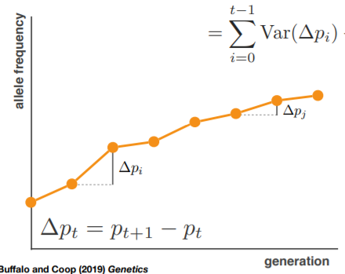
Temporal covariance in allele frequency change
Under Drift
Under Directional Selection
allele frequency
allele frequency
generation
generation
Buffalo and Coop 2019, Genetics
Notes:
In the future we want to pair this analysis with measures of temporal covariance in allele frequency change to identify signatures of polygenic selection. Under drift, we expect random changes in allele frequencies across generations, so that the covariance in allele frequency change between generations is around zero. Under directional selection we expect a positive covariance. This is due to the effects of linked selection. If we imagine there was an allele that was on an advantageous background, it would increase in frequency between generation 1 and generation 2, leading to a positive change in allele frequency. As long as that allele remained associated with this advantageous background, it is also expected to increase in frequency in later generations. This creates a positive temporal covariance. Another important thing is that, under selection, this covariance will be higher for snps that are more tightly linked.

Slide 47
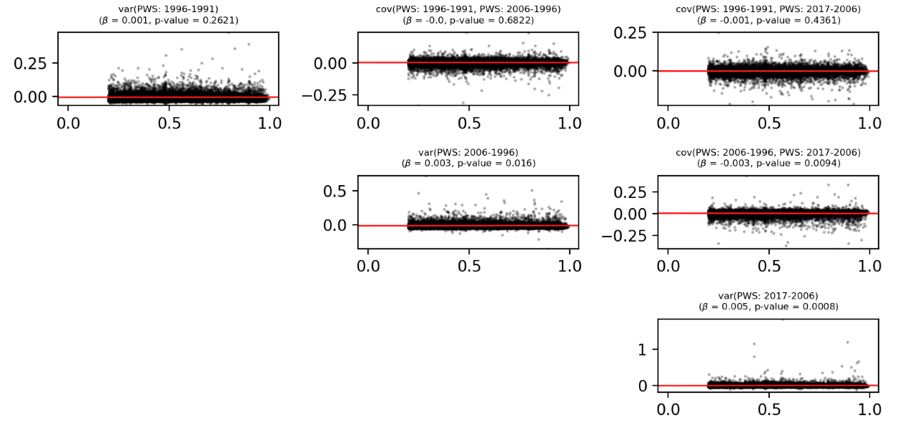
Signs of linked selection post-spill using temporal covariance in allele frequency changes
temporal covariance
LD
LD
Notes:
So this is still very much a work in progress, Vince just sent me these latest results on Friday. So this is preliminary, but I think it will help show how we are thinking about selection in this system. Also, this stuff is just really cool and I’m excited about it. So here we are looking at the relationship between temporal covariance in allele frequency change on the y and linkage disequilibrium on the x binned into 10kb windows. Like I mentioned a second ago, under directional selection, we expect that temporal covariance will be higher in regions showing higher LD.Drift would not produce the same pattern. If we run a linear regression, we do not see a significant relationship looking at the covariances from 1996-1991 and 2017-2006 frequency changes. However, we do see a significant relationship at the later time points that do not include the 1991 samples. The relationship is really subtle, but that’s expected. Overall, this might suggest that selection pressures were more similar in the years when disease outbreaks were most prevelent, which is again consistent with this idea of fluctuating selection pressures in PWS.

Slide 48
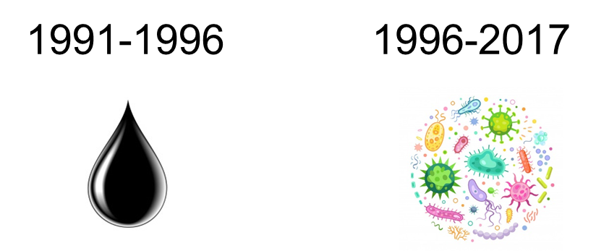
Signs of linked selection post-spill using temporal covariance in allele frequency changes
temporal covariance
LD
LD
Notes:
So this is still very much a work in progress, Vince just sent me these latest results on Friday. So this is preliminary, but I think it will help show how we are thinking about selection in this system. Also, this stuff is just really cool and I’m excited about it. So here we are looking at the relationship between temporal covariance in allele frequency change on the y and linkage disequilibrium on the x binned into 10kb windows. Like I mentioned a second ago, under directional selection, we expect that temporal covariance will be higher in regions showing higher LD.Drift would not produce the same pattern. If we run a linear regression, we do not see a significant relationship looking at the covariances from 1996-1991 and 2017-2006 frequency changes. However, we do see a significant relationship at the later time points that do not include the 1991 samples. The relationship is really subtle, but that’s expected. Overall, this might suggest that selection pressures were more similar in the years when disease outbreaks were most prevelent, which is again consistent with this idea of fluctuating selection pressures in PWS.

Slide 49
Population recovery
Motivation
PWS experienced a decline in population size.
Rapid adaptation to pollutants can favor genetic variation that impairs the function of signaling pathways important for healthy immune systems.
Hypotheses
Genetic variation was favored that conferred resistance to oil exposure immediately after the spill. The same variation is now deleterious because it affects proper immune function.
PWS may show a higher frequency of deleterious alleles post-spill.
PWS may show genetic signatures of fluctuating selection pressures.
Notes:
So relating all of this back to our hypothesis, it looks like we do see some genomic evidence consistent with fluctuating selection pressures in Prince William Sound. We can see this for specific genes in the AHR pathway, across really large regions of chromosome 7 and 12, and more broadly across the genome using looking at temporal covariance in allele frequency changes.

Slide 50
Takeaways
The Prince William Sound population shows a decline in effective population size between 1991 and 2017.
Loss-of-function mutations are not more common in Prince William Sound after the oil spill, suggesting that lack of population recovery is not driven by an overall increase in mutation load.
Temporal changes in allele frequency are consistent with fluctuating selection pressures in Prince William Sound.

Slide 51
Outline
Genetic variation underlying pollution resistance and susceptibility to disease.
Inversions underlying local adaptation.

Slide 52
Temporal shifts in allele frequency between 1991 and 1996 Prince William Sound
1MB windows

Slide 53
Fst: 2017 comparisons
CA
WA
BC
SS
PWS
TB
TB
PWS
SS
BC
WA
CA
Notes:
Here is what Fst looks like, and it lines up pretty well with what I showed in the PCA, with the Togiak Bay population being the most divergent, followed by the California population, and then we see very little structure among NorthEast Pacific populations. Ok, so those are just a couple of genome-wide summary statistics to give you a sense of the data I have. Now I want to use this data to test some hypotheses.

Slide 54
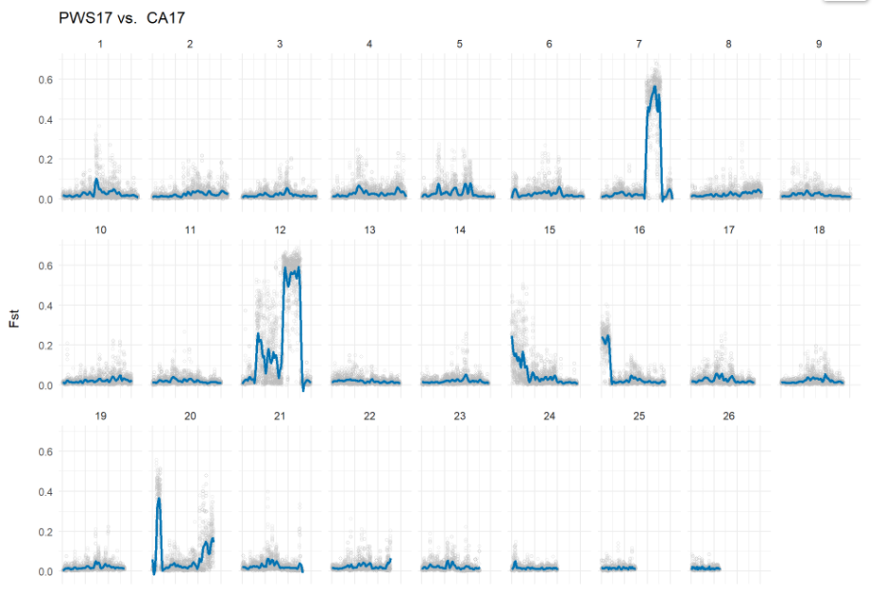
Fst California vs. Prince William Sound
Notes:
What’s really cool is that inversions were recently discovered in southern populations of Atlantic herring too. Atlantic herring and pacific herring are about 3 million years diverged. One of the inversions occurs at the same region on chromosome 12! In both systems, inversions are present in populations in warmer waters. As you move south, herring tend to be

Slide 55
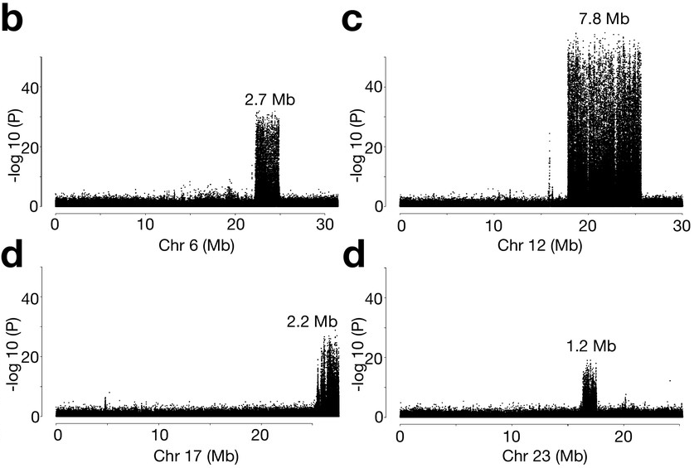
Recent discovery of inversions in Atlantic herring
Han et al. 2020, elife
Notes:
What’s really cool is that inversions were recently discovered in southern populations of Atlantic herring too. Atlantic herring and pacific herring are about 3 million years diverged. One of the inversions occurs at the same region on chromosome 12! In both systems, inversions are present in populations in warmer waters. As you move south, herring tend to be

Slide 56
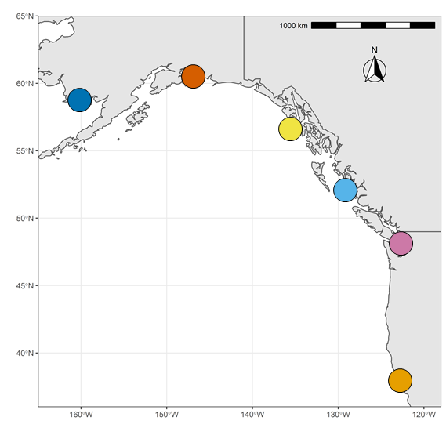
Latitudinal differences between populations
Trends from North to South
smaller size
sexually mature earlier
spawn earlier in the year
die younger
Hay et al. 2008, Progress in Oceanography

Slide 57
Local adaptation driven by supergenes?
Han et al 2020, elife
Notes:
So its possible that you have a bunch of genes that influence some of these traits, and they are all clumped together on an inversion, the whole cluster can be inherited as a large supergene. The inversion suppresses recombination so that linkage between those adaptive genes in maintained over time. Its possible that this is a common genetic mechanism of adaptation in marine species where gene flow is frequent across long ranges.

Slide 58
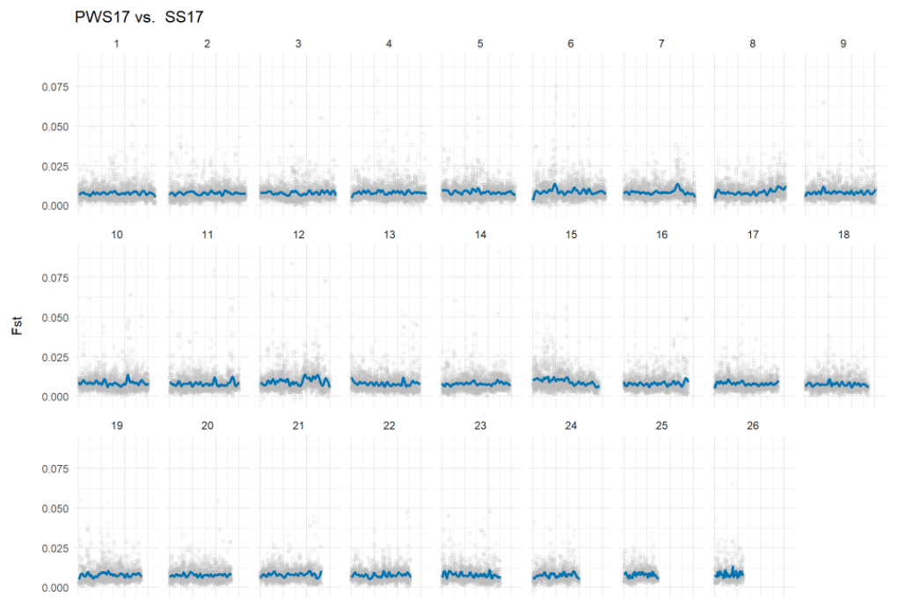
Fst Prince William Sound vs. Sitka Sound

Slide 59
Takeaways
Putative inversions are segregating at high frequency in the California population.
Parallel ecological adaptations in Pacific and Atlantic herring may result from similar genetic mechanisms.
Inversions may also play a role in slow population recovery in Prince William Sound.

Slide 60



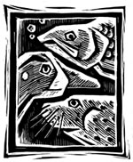
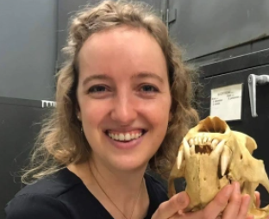



Whitehead Lab:
Thanks!
Questions?
Andrew Whitehead
Jenn Roach
Nichole McNabb
Joanna Griffiths
Elias Oziolor
Vince Buffalo
Tony Tercero
Tony Gill
Exxon Valdez Oil Spill
Trustee Council

Slide 61
Temporal covariance in allele frequency change

Slide 62
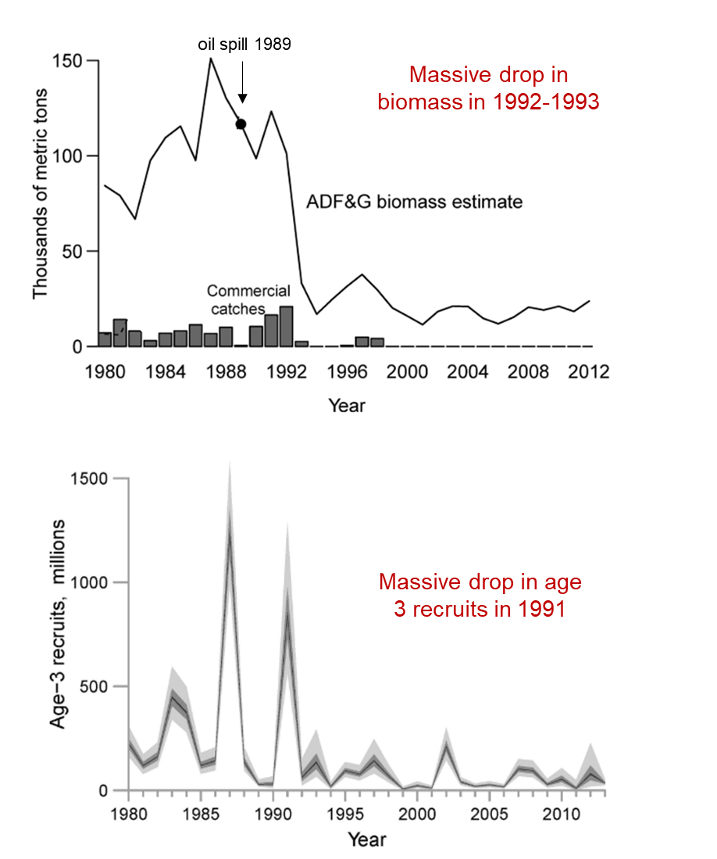
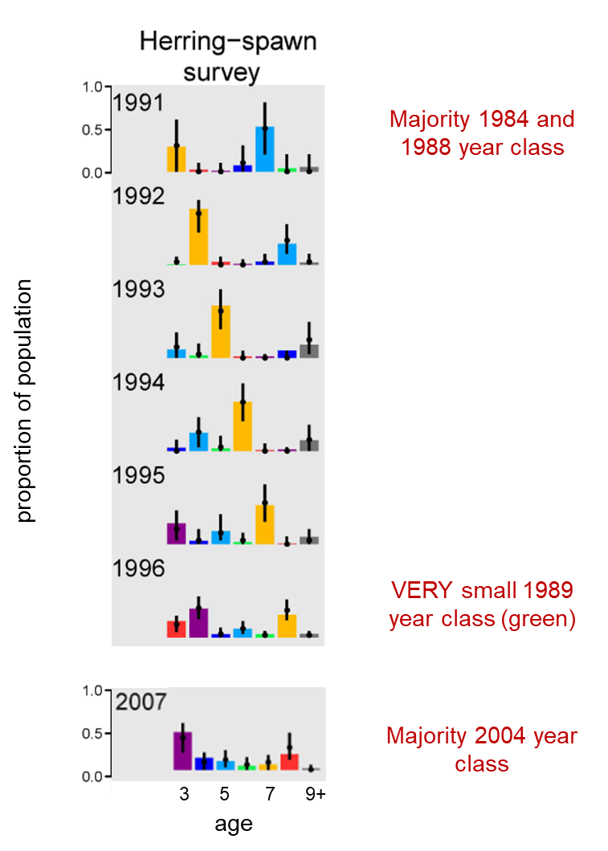

Slide 63

Population genetics: Fst Prince William Sound vs. Togiak Bay

